Slide 1
Images for User Guide

Slide 2
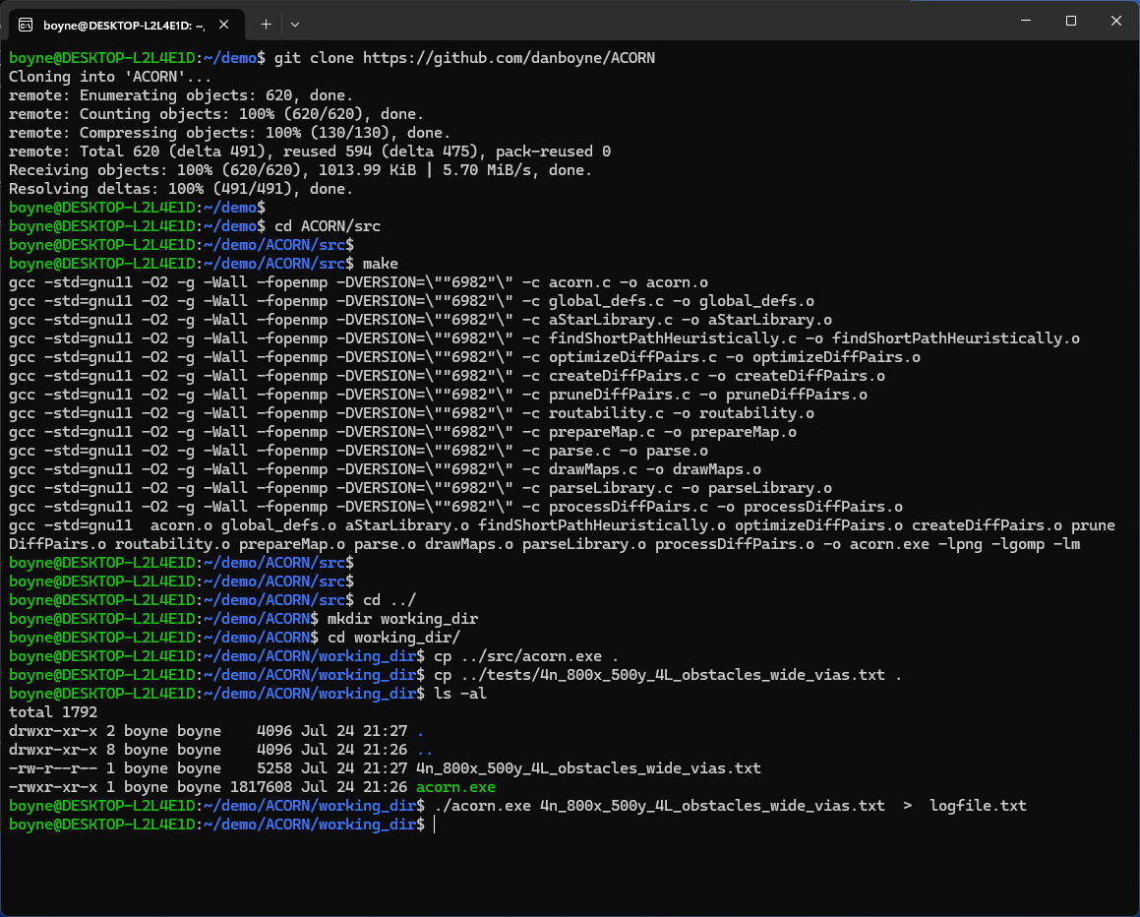
Download Acorn from GitHub
Type 'make' in 'src' directory to compile Acorn.
Copy 'acorn.exe' and a test-case to a working directory
Run Acorn

Slide 3
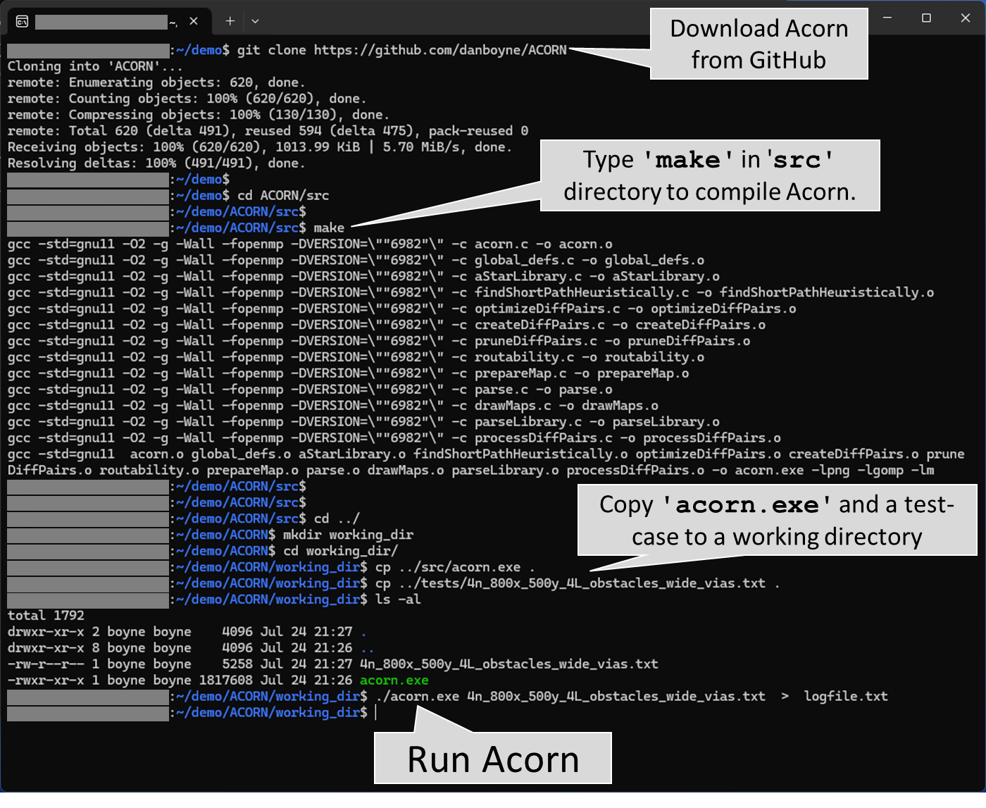

Slide 4
Images for Manuscript

Slide 5
Problem Scope

Slide 6
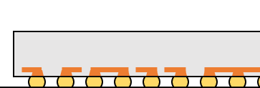
Redistribution layer(s) on die
Routing layers on
flip-chip package
PCB
routing

Slide 7
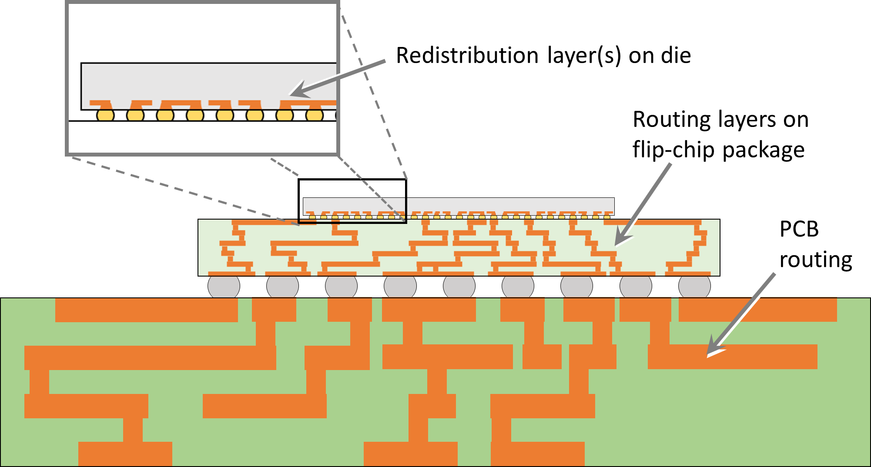

Slide 8
Routing Layers and Boundaries

Slide 9
a.
Boundaries for die-to-package vias
Boundaries for package-to-PCB vias
y
x
Boundaries for routing layer on dies
Boundaries for package routing layers
Boundaries for PCB routing layers
Die
#1
Die
#2
Die
#3
Package
#1
Package
#2
b.
Layers shown are routing layers, and should not be confused with laminate layers, each of which can contain multiple routing layers.
Die
#1
Die
#2
Die
#3
y
Package #1
Package #2
There is no restriction that each die (or package) must have the same number of routing layers as other die (packages) on the PCB.
x
PCB
z

Slide 10
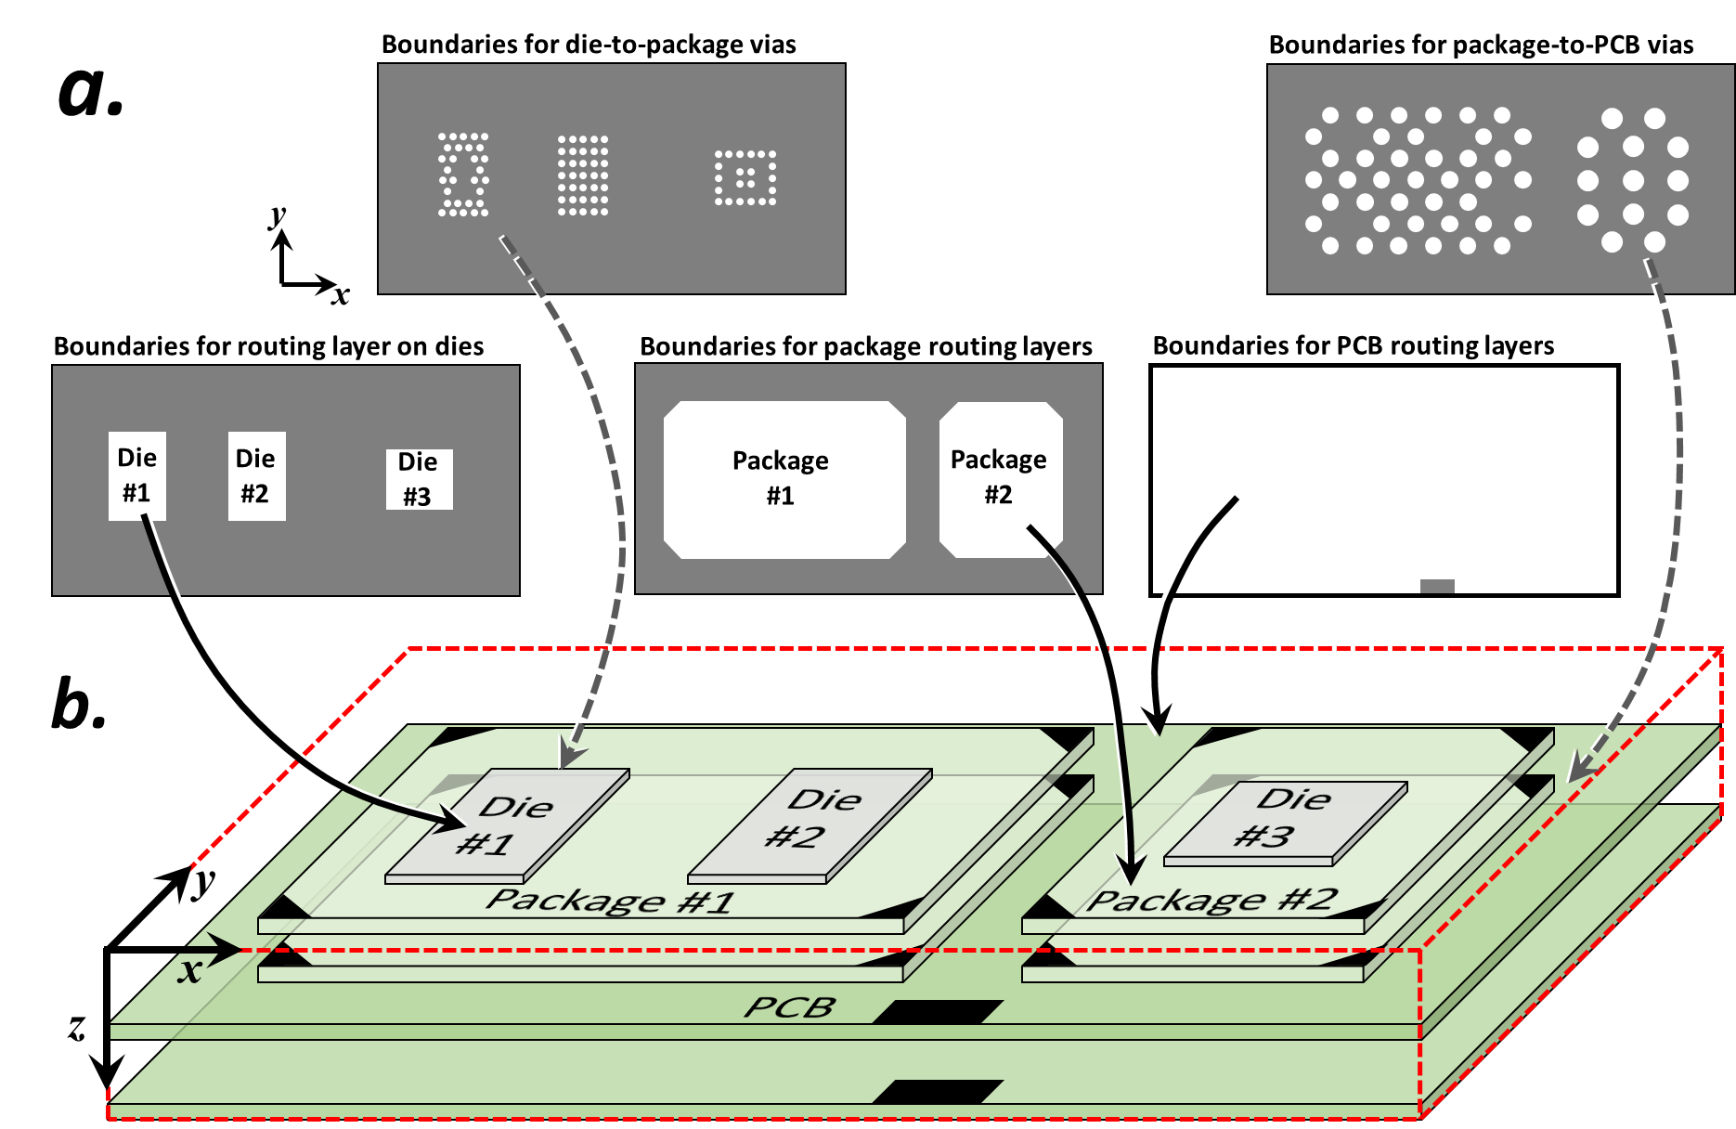

Slide 11
Routing Design Rules

Slide 12
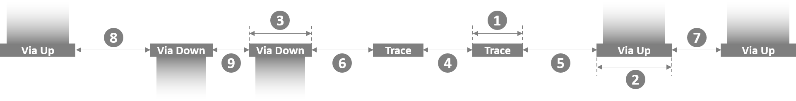

Slide 13
Pin Swapping

Slide 14
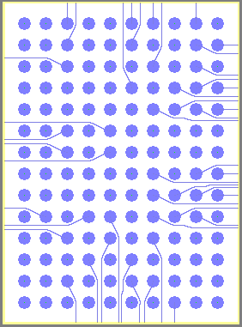
a.
b.
Two pin-swap zones
RAM
8 swap-
pable
terminals
8 swap-
pable
terminals
Non-swappable terminals
Lower-left corner of pin-swap zone
(yellow) contains terminals of all nets.

Slide 15
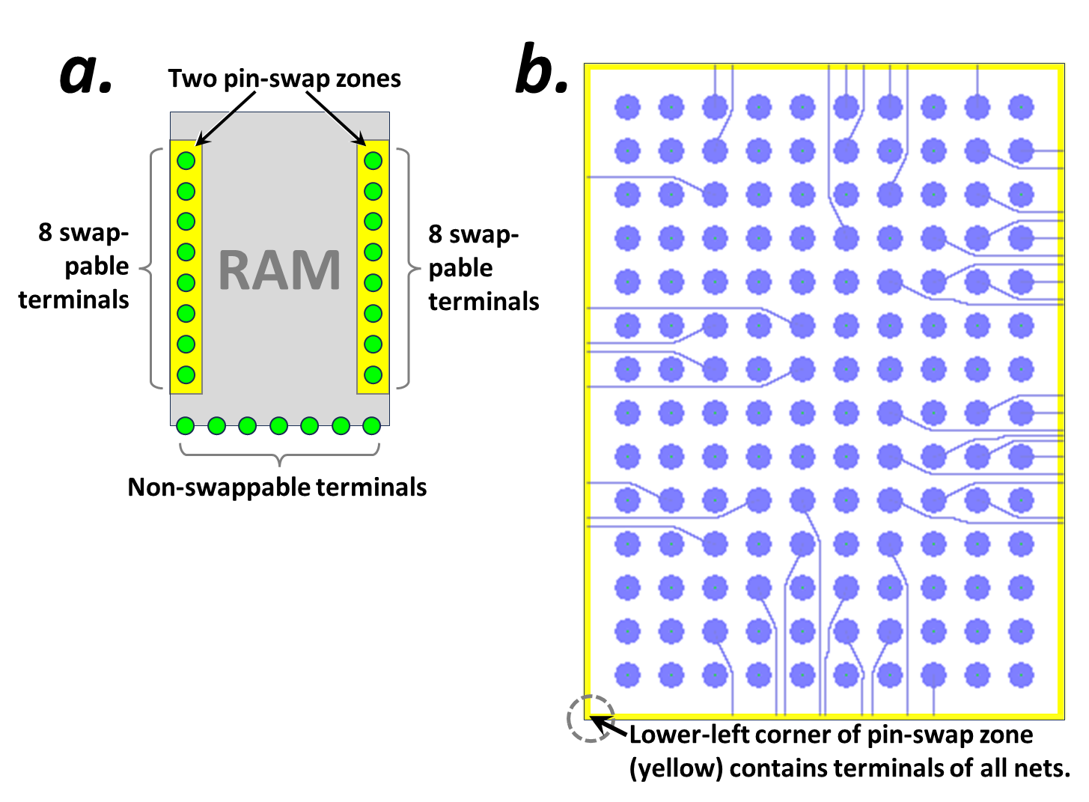

Slide 16
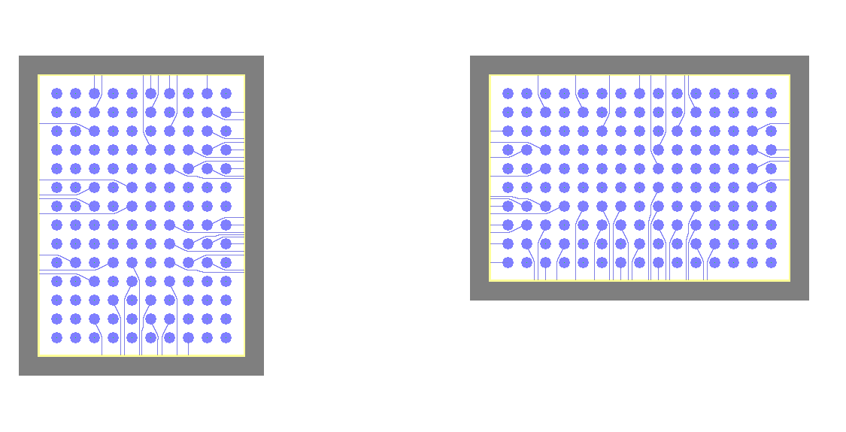
\\wsl.localhost\Ubuntu\home\boyne\autorouter\REGRESSION_TESTING--c7g.4xlarge--5Jul2024\90n_45mmX23mm_1L_twoSingleComponentEscapeRouting_40umRes\map_iter0146_02_ROUTING.png

Slide 17
Escape Routing

Slide 18
Die
Package
Single pin-swap zone along base of package
(yellow) contains terminals of all nets.

Slide 19
Single pin-swap zone along perimeter of PCB
(yellow) contains terminals of all nets.
Die
Package
PCB

Slide 20
a.
Die
Package
Single pin-swap zone along base of package (yellow) contains terminals of all nets.
b.
Single pin-swap zone along perimeter of PCB
(yellow) contains terminals of all nets.
Die
Package
PCB

Slide 21
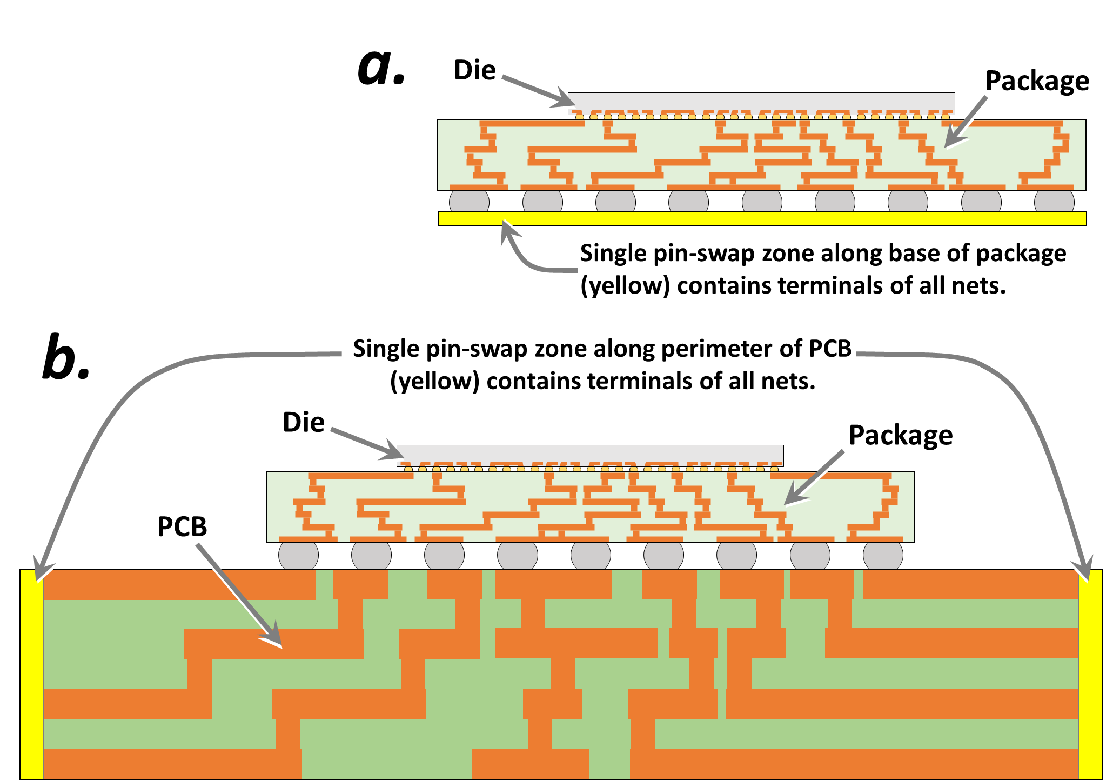

Slide 22
Algorithm

Slide 23
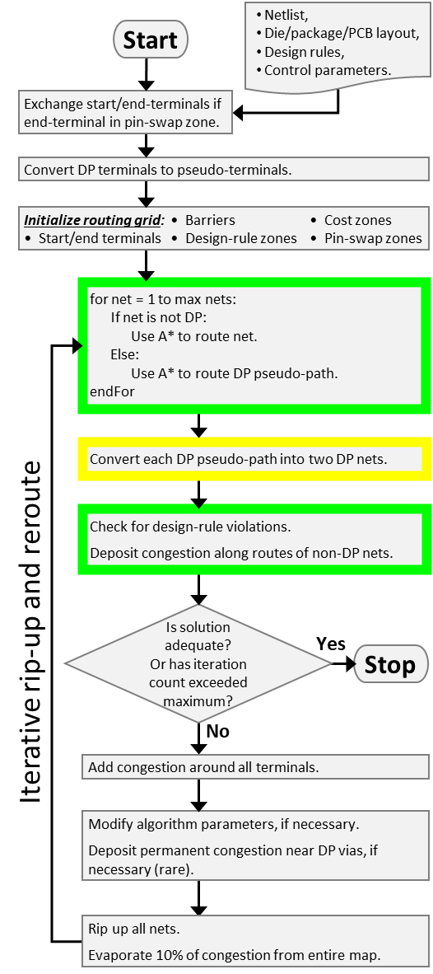
Netlist,
Die/package/PCB layout,
Design rules,
Control parameters.
Start
Exchange start/end-terminals if end-terminal in pin-swap zone.
Convert DP terminals to pseudo-terminals.
Initialize routing grid: • Barriers • Cost zones
• Start/end terminals • Design-rule zones • Pin-swap zones
for net = 1 to max nets:
If net is not DP:
Use A* to route net.
Else:
Use A* to route DP pseudo-path.
endFor
Convert each DP pseudo-path into two DP nets.
Check for design-rule violations.
Deposit congestion along routes of non-DP nets.
Is solution adequate?
Or has iteration count exceeded maximum?
Iterative rip-up and reroute
Yes
Stop
No
Add congestion around all terminals.
Modify algorithm parameters, if necessary.
Deposit permanent congestion near DP vias, if necessary (rare).
Rip up all nets.
Evaporate 10% of congestion from entire map.

Slide 24
Netlist,
Die/package/PCB layout,
Design rules,
Control parameters.
Start
Exchange start/end-terminals if end-terminal in pin-swap zone.
Convert DP terminals to pseudo-terminals.
Initialize routing grid: • Barriers • Cost zones
• Start/end terminals • Design-rule zones • Pin-swap zones
for net = 1 to max nets:
If net is not DP:
Use A* to route net.
Else:
Use A* to route DP pseudo-path.
endFor
Convert each DP pseudo-path into two DP nets.
Check for design-rule violations.
Deposit congestion along routes of non-DP nets.
Is solution adequate?
Or has iteration count exceeded maximum?
Iterative rip-up and reroute
Yes
Stop
No
Modify algorithm parameters, if necessary.
Deposit permanent congestion near DP vias, if necessary (rare).
Rip up all nets. Evaporate 10% of congestion from entire map.

Slide 25
Is connection on 1 layer?
Try a simple, geometric-based heuristic to optimize wiring configuration.
Start
Yes
No
Does geometric heuristic provide conclusive answer?
Sample the previous congestion around the connection's 4 terminals.
No
Does previous congestion unambiguously reveal previous wiring configuration?
Yes
No
Run compute-intensive optimation and assign 'swap' value based thereon.
Assign 'swap' value based on geometric heuristic.
Yes
Do diff-pair paths have DRCs on previous iterations?
Yes
Assign 'swap' value based on previous congestion.
End
No

Slide 26
Start
Compare FC_{NS} & FC_{S}
NS > S
NS < S
NS ≈ S
Compare DRC_{NS} & DRC_{S}
NS > S
NS < S
NS ≈ S
Compare GDIST_{NS} & GDIST_{S}
NS > S
NS < S
NS ≈ S
Compare G_{NS} & G_{S}
NS > S
NS < S
NS ≈ S
Compare DIST_{NS} & DIST_{S}
NS > S
NS < S
NS ≈ S
Swap connections
Don't swap connections
End

Slide 27
Auto-router algorithm flow-chart 23 Jan 2018
Key variable: evaporation rate
Start
pathFinderRun = 1 ?
N
optimizationRun
= TRUE ?
N
evaporateCongestion
Y
Y
pathFinderRun++
pathNum = 0
solutionFound = FALSE
optimizationRun = FALSE
pathFinderRun = 0
samePathBenefit = 1
Y
Run the findPath routine on path #pathNum
N
pathNum
< numPaths ?
Increment pathNum
pathFinderRun < maxIterations ?
solutionFound = TRUE ?
N
Y
createContiguousPath
N
Y
optimizationRun = TRUE ?
calcRoutabilityMetrics
Y
update_congestion_map
Adds congestion from latest pathfinder runs
N
num_crossings = 0 ?
Y
N
Key variable: how many zero-crossing solutions before solution is ‘good’?
Stop
Was good solution found ?
Y
N
Y
optimization_run = TRUE ?
optimization_run = FALSE
N
optimization_run = TRUE
samePathBenefit = 0
clearUnsuccessfulCongestion

Slide 28
Routing Grid Definition (allowed directions)

Slide 30
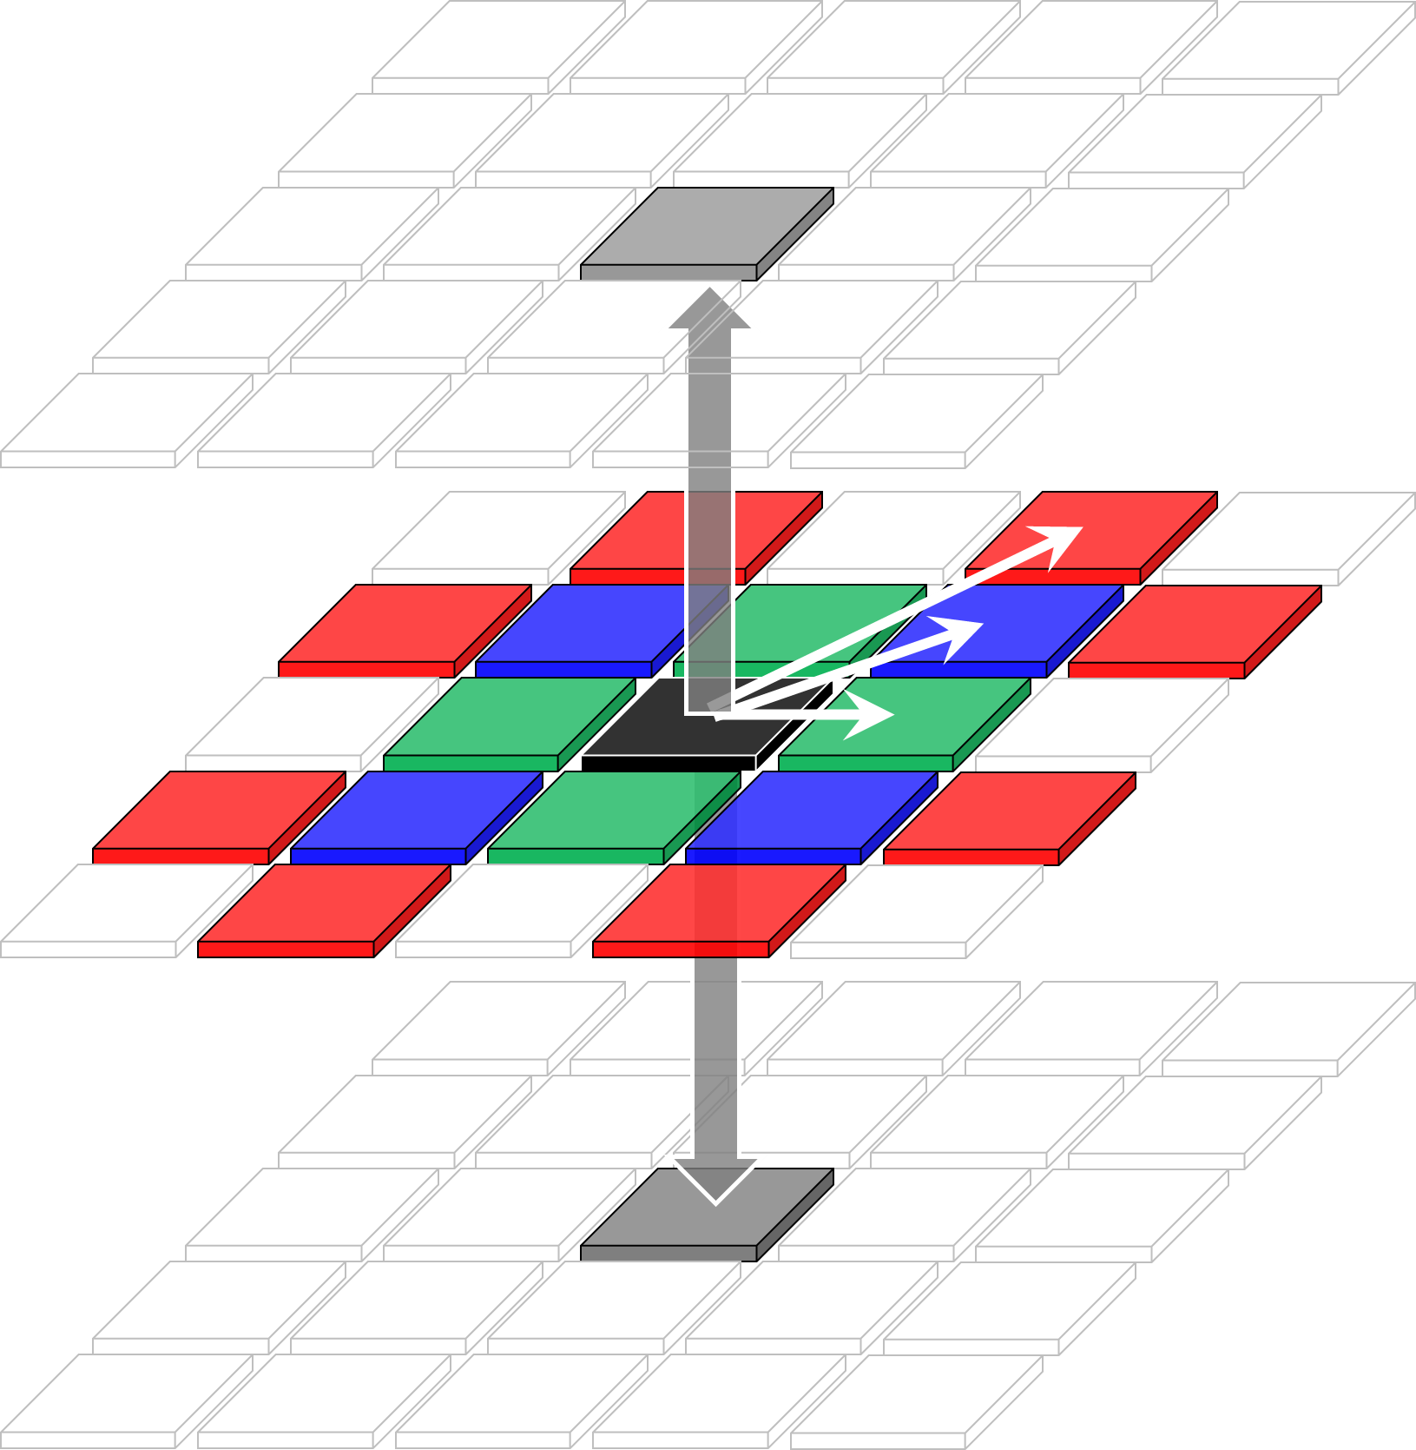

Slide 31
Congestion Deposition

Slide 33

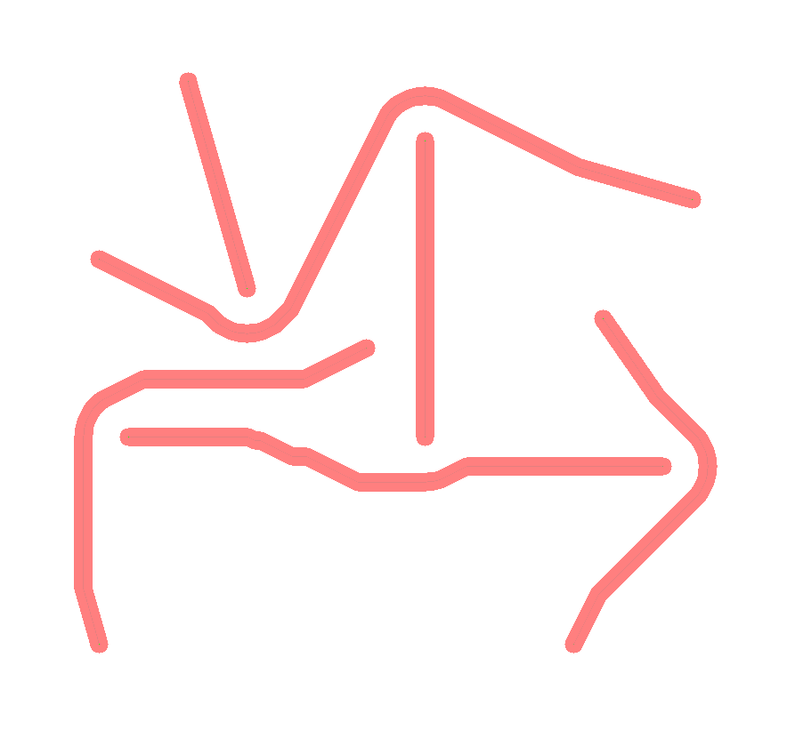
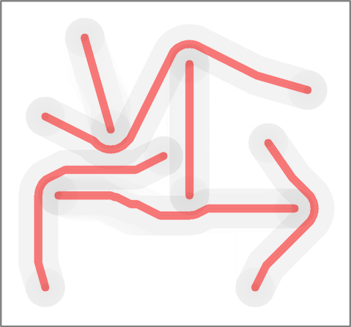

Slide 35










Slide 36
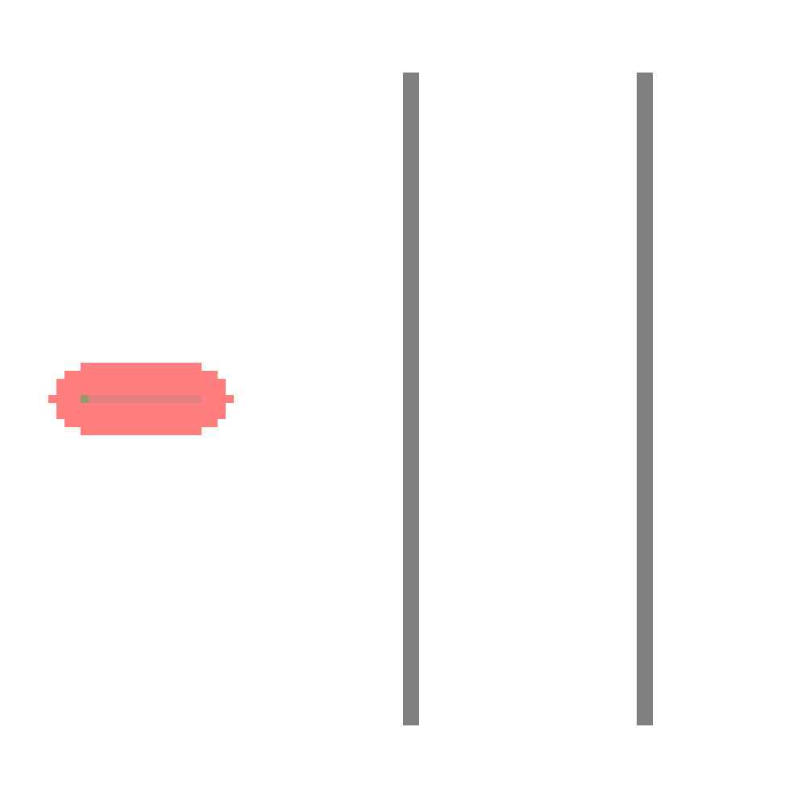
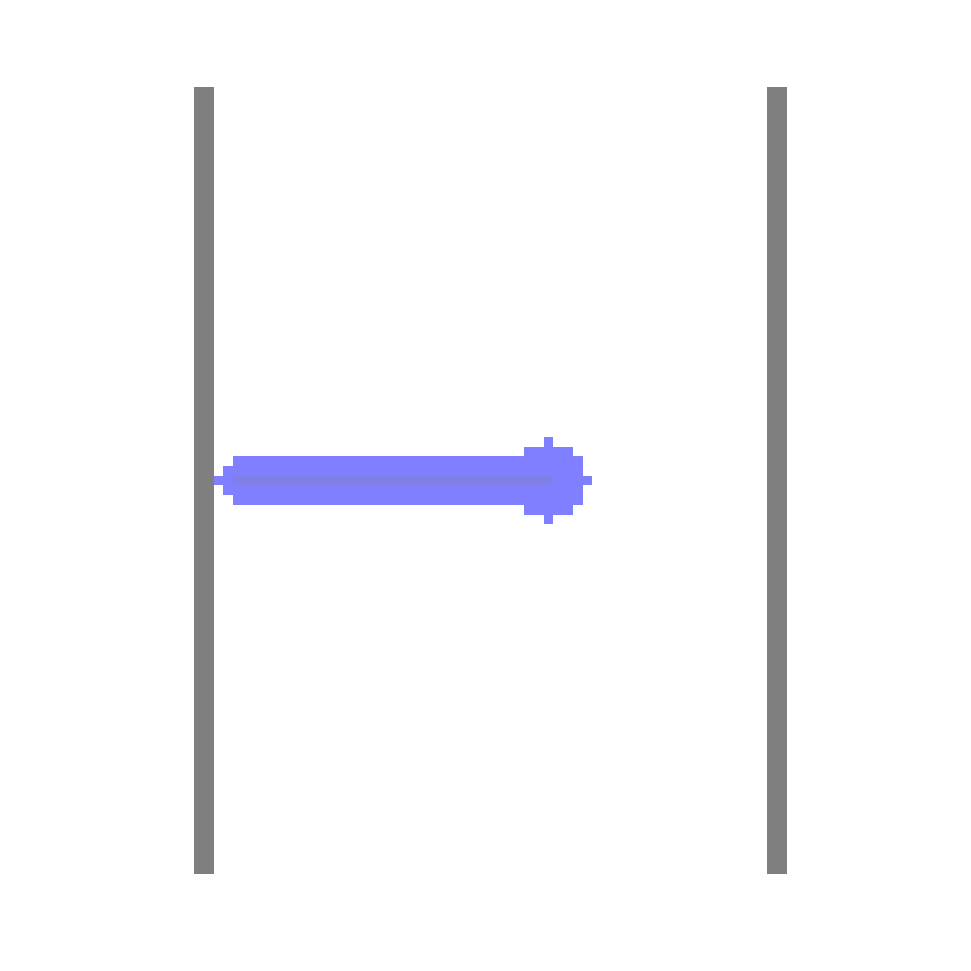
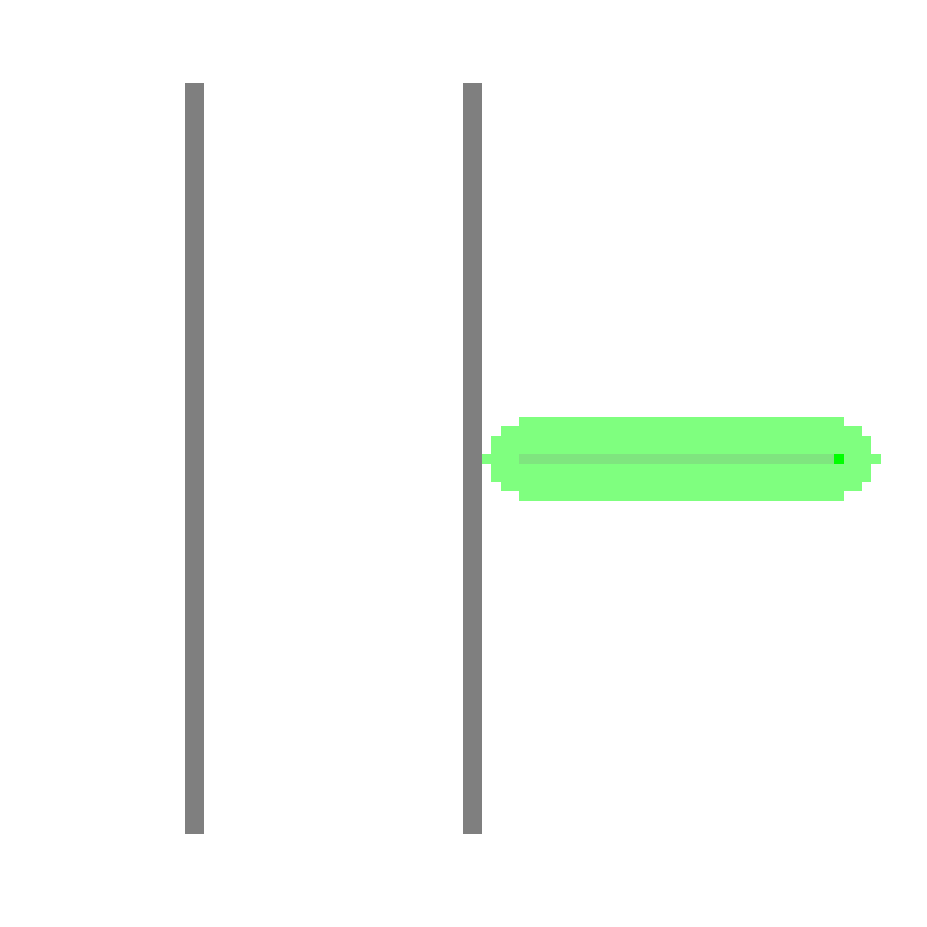
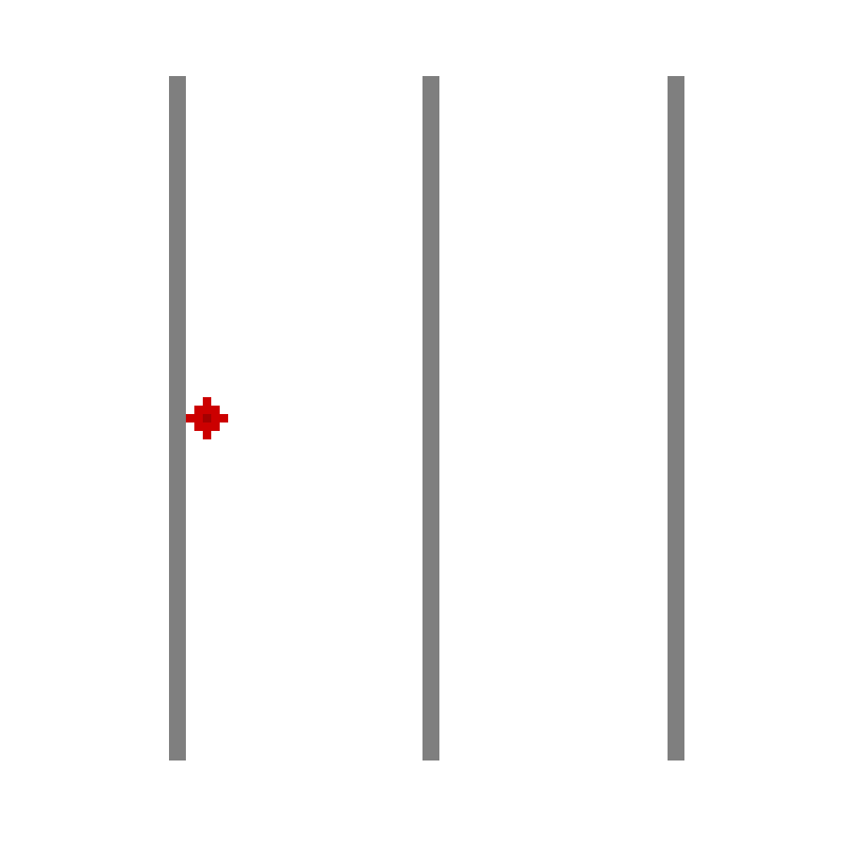
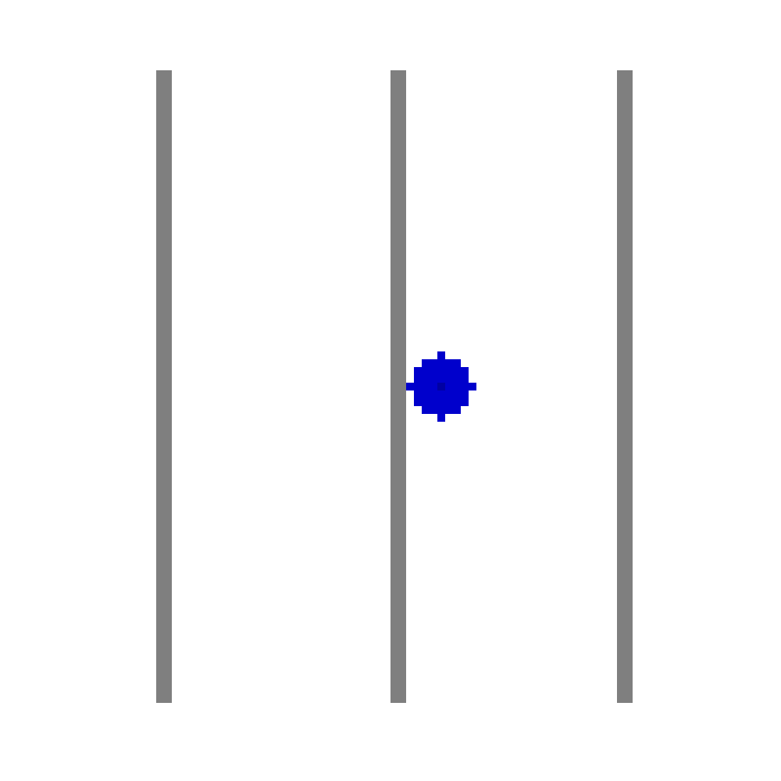

Slide 38
Iterative Routing (when to stop?)

Slide 40
Post-processing Differential Pairs
Pseudo-path to shoulder-paths
Creating vias
Deciding which via connects to which path
Filling in the gaps

Slide 45
DP vias

Slide 49
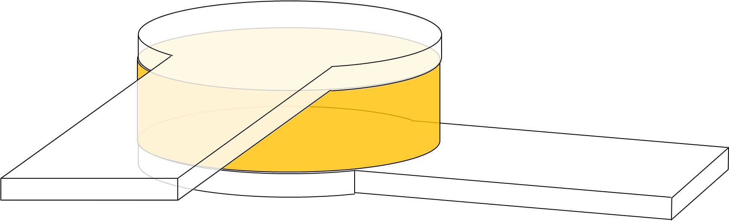
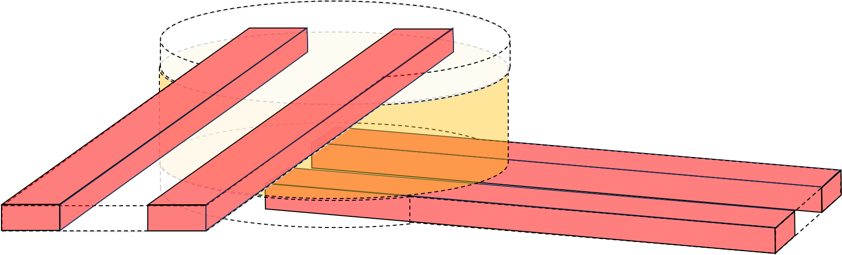
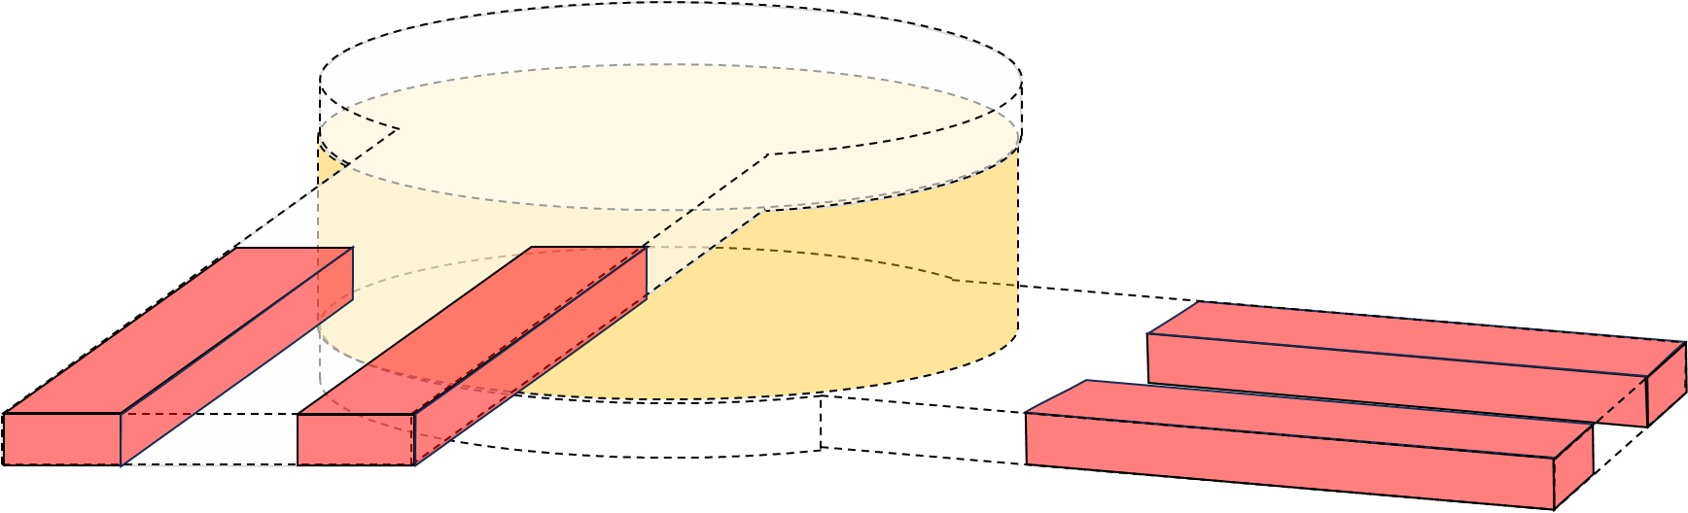
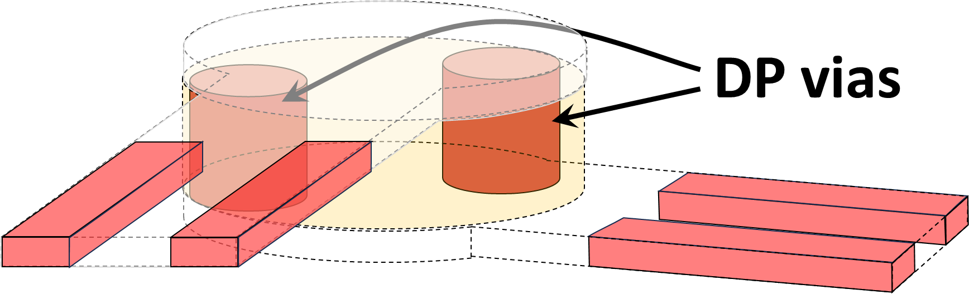
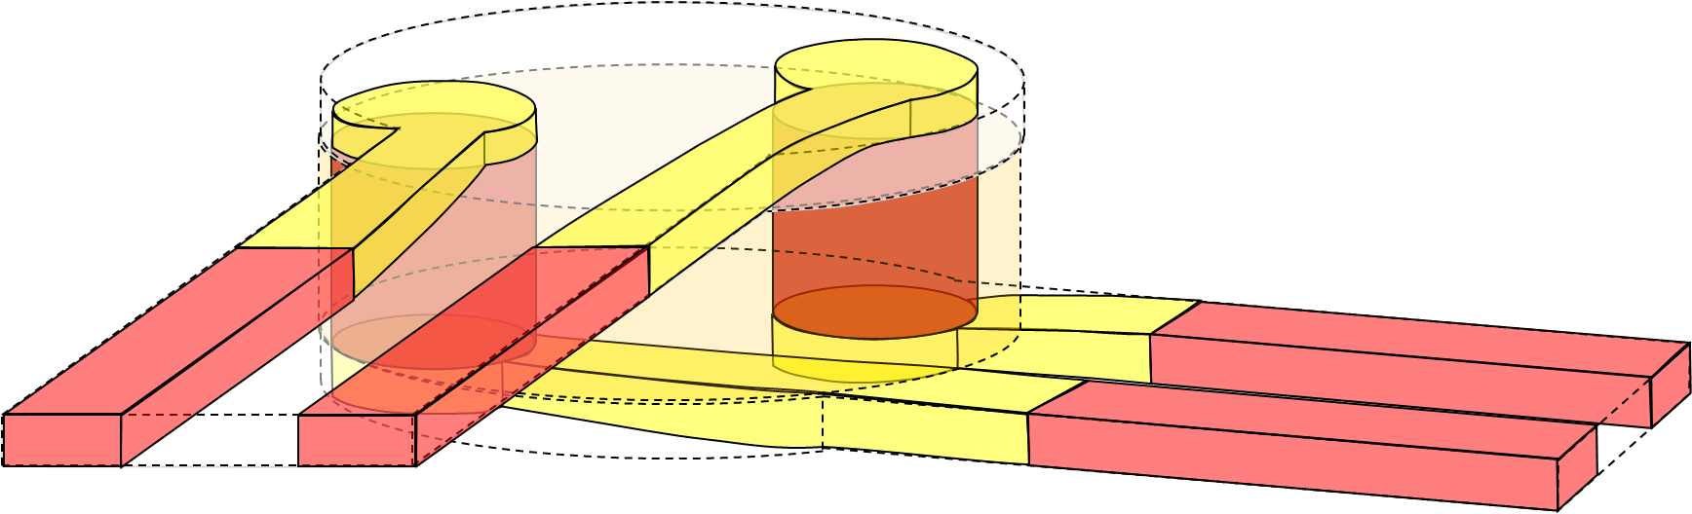
Pseudo
traces
a.
Pseudo
via
Parallel
DP traces
b.
Pruned
DP traces
c.
d.
A*-routed
connections
e.

Slide 50
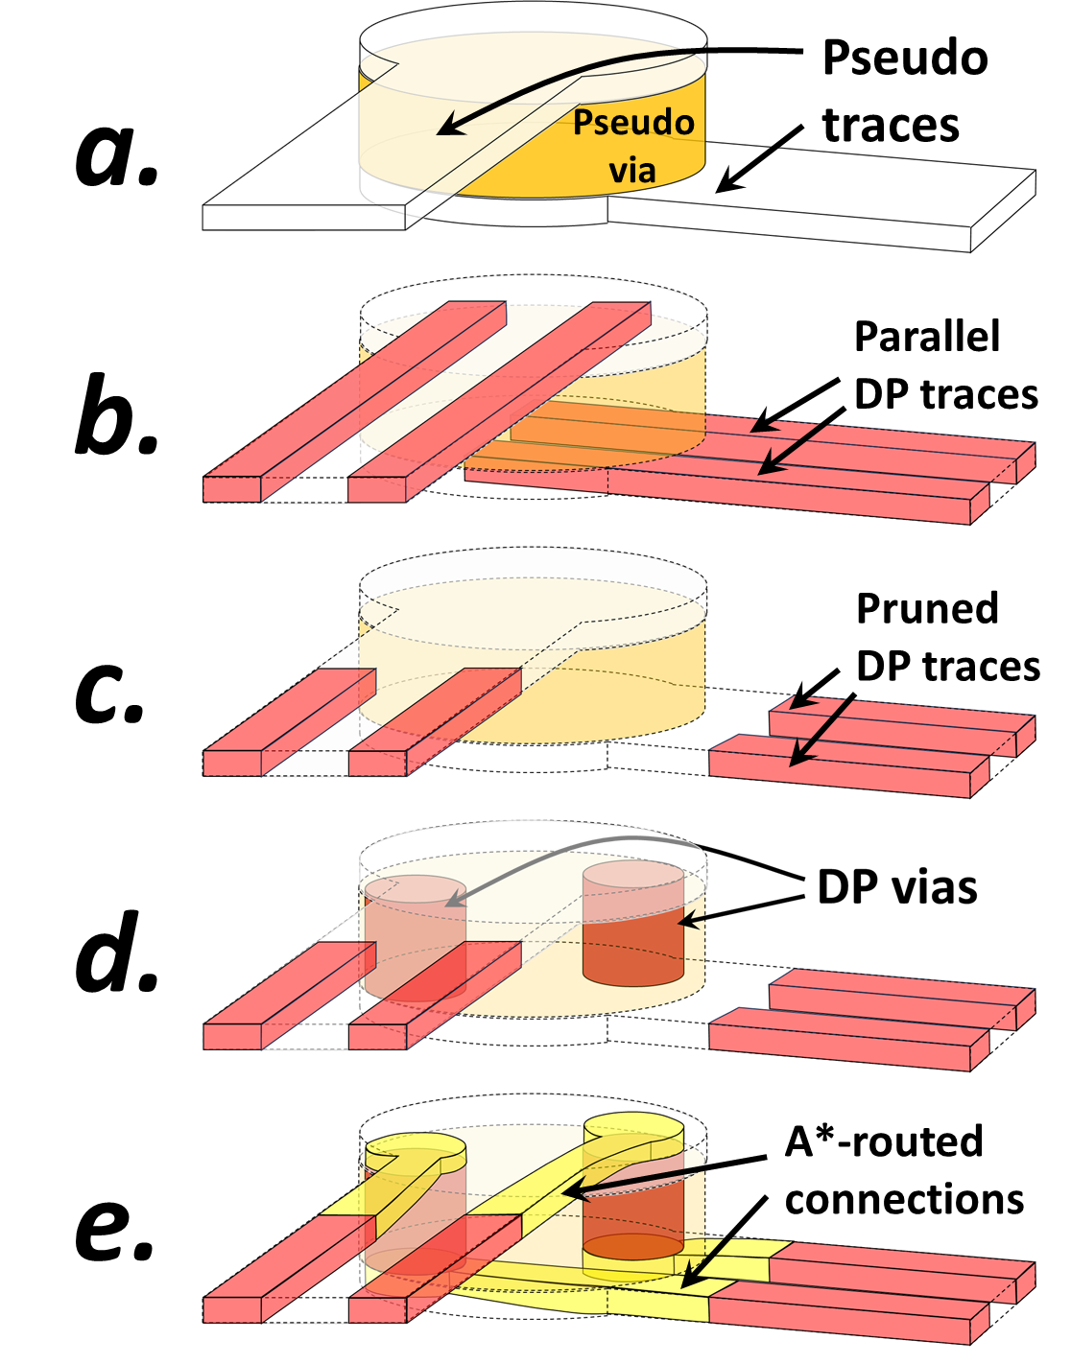

Slide 51
Real-time Algorithm Tuning

Slide 52
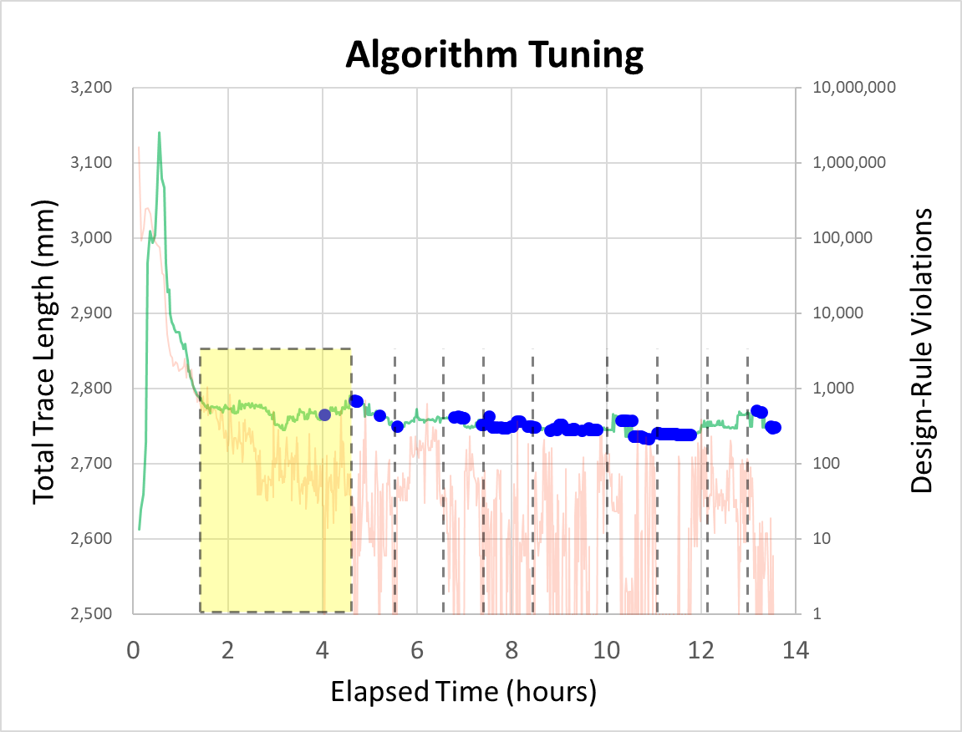
Swap start- and
end-terminals
Adjust sensitivity to congestion
Gradually increasing congestion sensitivity.
Iterations with no design-rule violations

Slide 53
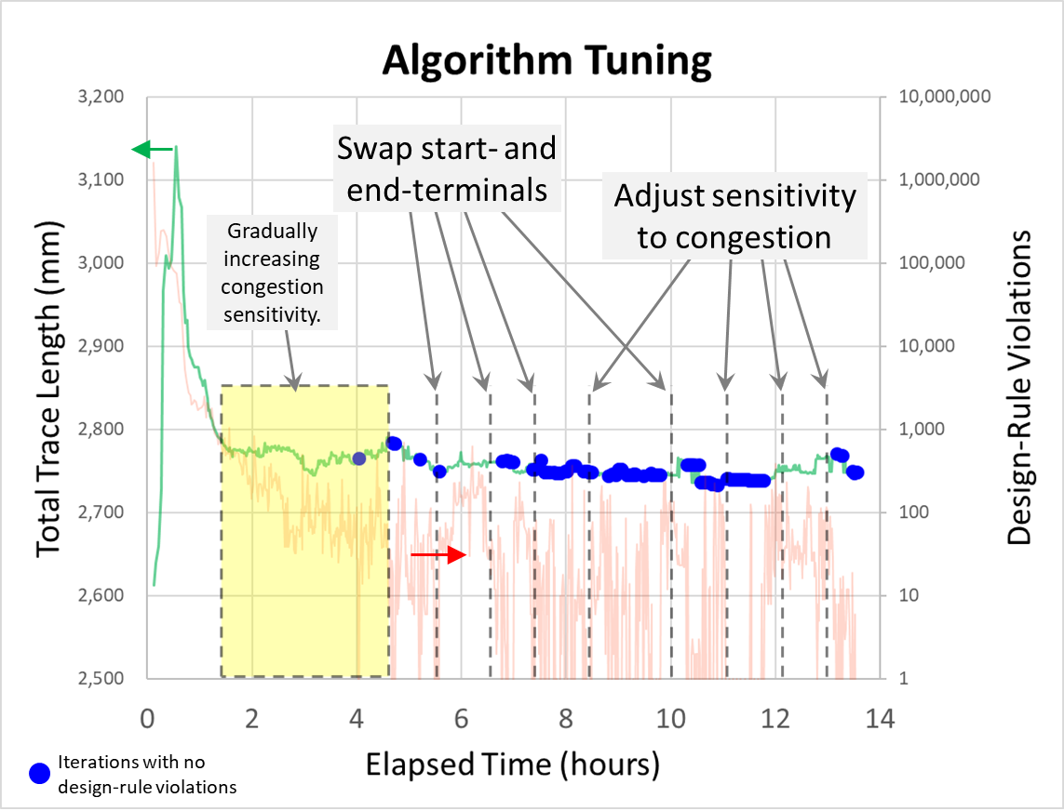

Slide 54
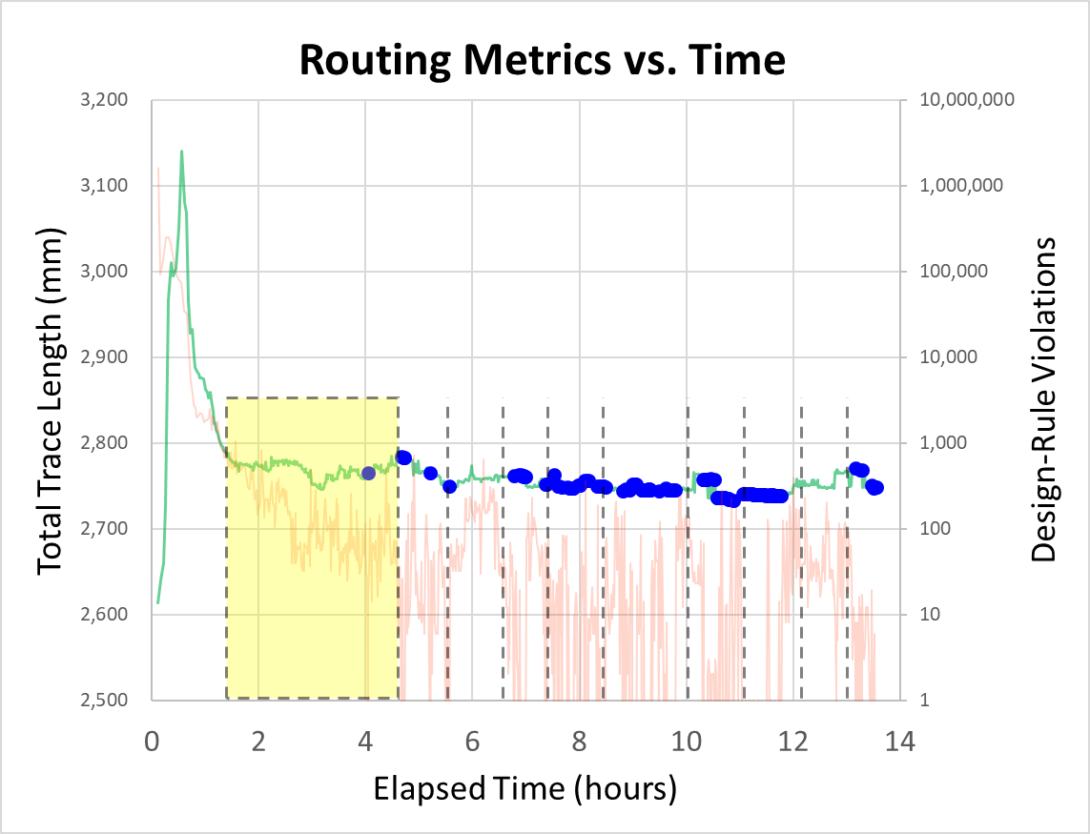
Swap start- and
end-terminals
Adjust sensitivity to congestion
Gradually increasing congestion sensitivity.
Iterations with no design-rule violations

Slide 55
DRC-free
solutions
DRC-free
solutions
After increasing
congestion
sensitivity
G-cost
G-cost
G-cost local minima
with design-rule violations
G-cost minima with design-rule violations
Routing Configurations
Routing Configurations

Slide 56
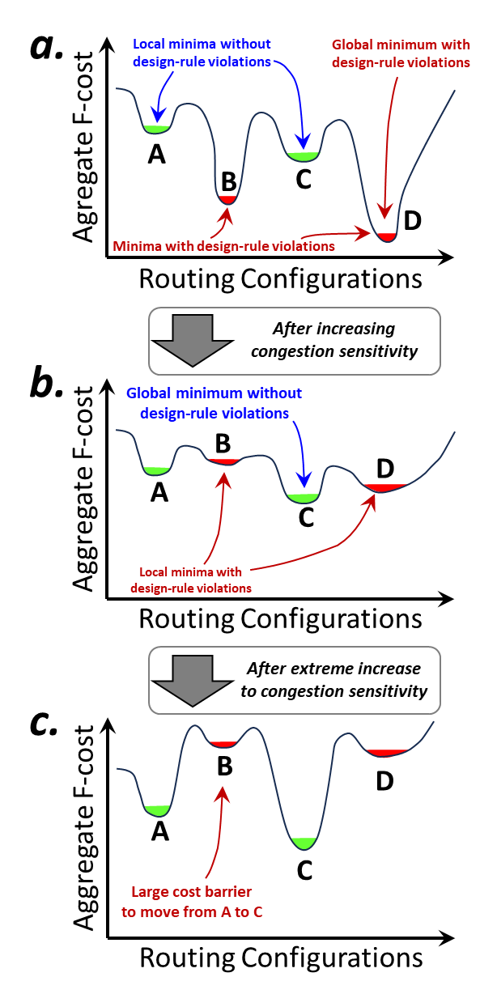
a.
Local minima without
design-rule violations
Global minimum with
design-rule violations
Agregate F-cost
A
B
C
D
Minima with design-rule violations
Routing Configurations
After increasing
congestion sensitivity
b.
Global minimum without
design-rule violations
B
D
Aggregate F-cost
A
C
Local minima with
design-rule violations
Routing Configurations
After extreme increase
to congestion sensitivity
c.
B
D
Aggregate F-cost
A
C
Large cost barrier
to move from A to C
Routing Configurations

Slide 57
After increasing
congestion sensitivity
After extreme increase
to congestion sensitivity
a.
b.
Local minima without
design-rule violations
Global minimum with
design-rule violations
Global minimum without
design-rule violations
B
D
Agregate F-cost
Aggregate F-cost
A
A
B
C
C
D
Minima with design-rule violations
Local minima with
design-rule violations
Routing Configurations
Routing Configurations
Figure 11: Conceptual representation of the total routing cost as a function of routing configurations (a). Increasing the congestion sensitivity (b) increases the cost of unwanted minima without affecting violation-free minima. Extreme increases to the sensitivity (c) cause large barriers between violation-free minima
c.
B
D
Aggregate F-cost
A
C
Large cost barrier
to move from A to C
Routing Configurations

Slide 59
Results: Package Routing

Slide 60
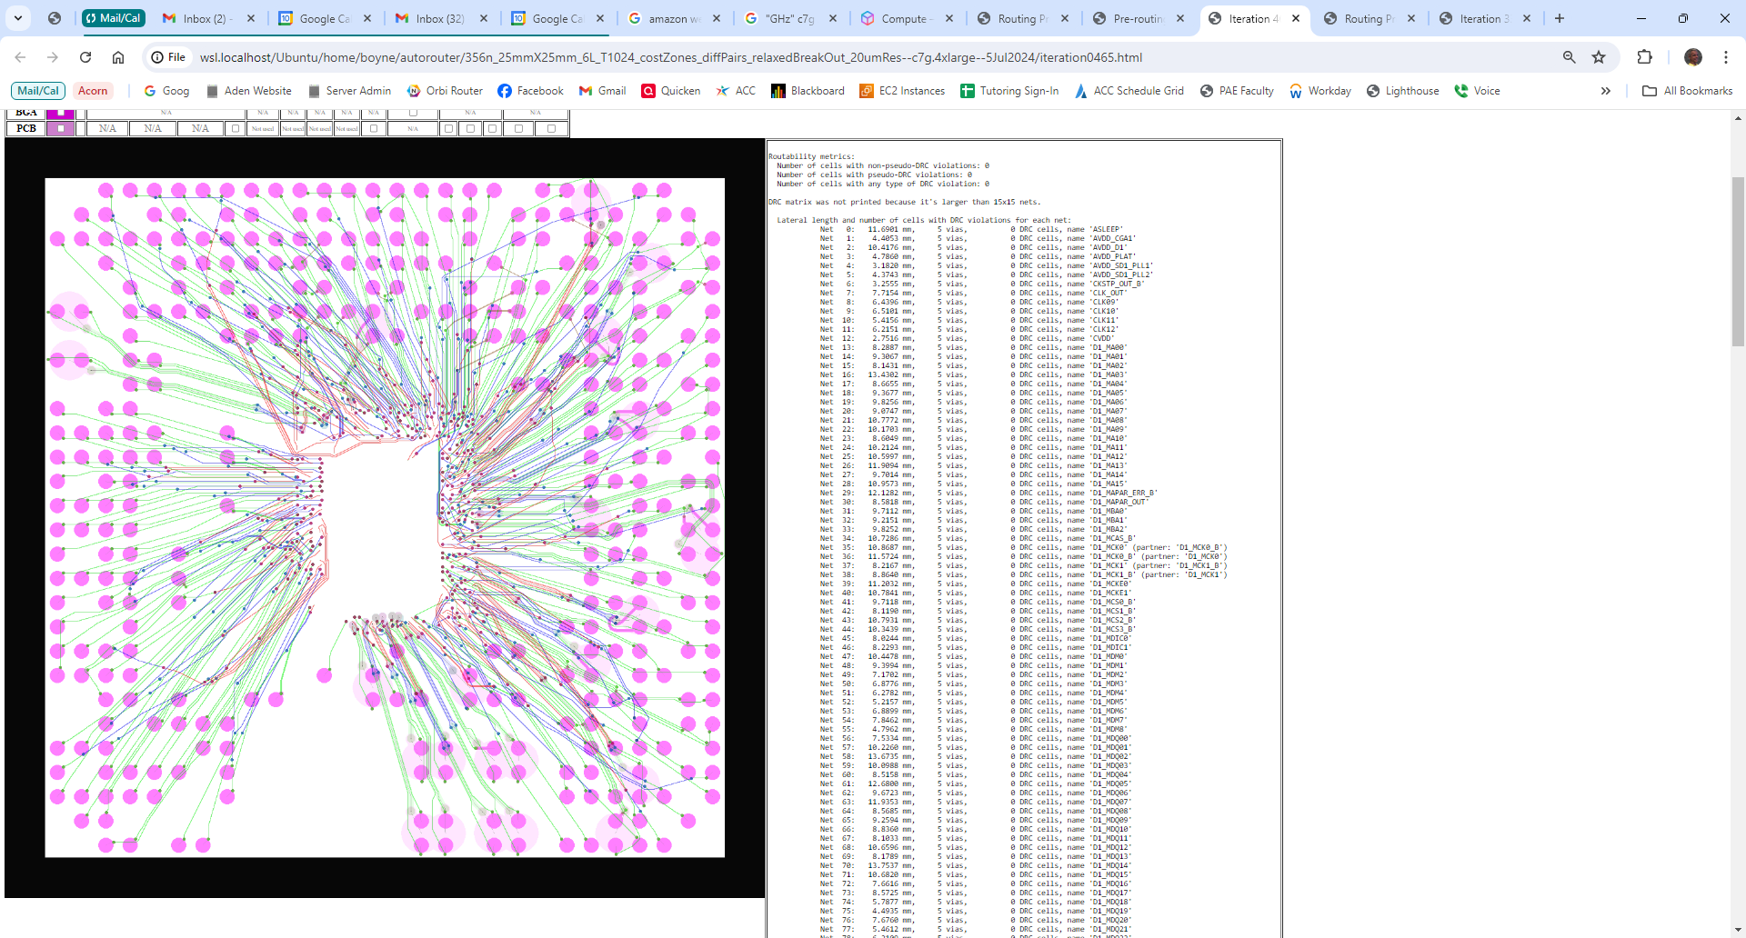
file://wsl.localhost/Ubuntu/home/boyne/autorouter/356n_25mmX25mm_6L_T1024_costZones_diffPairs_relaxedBreakOut_20umRes--c7g.4xlarge--5Jul2024/iteration0465.html

Slide 61
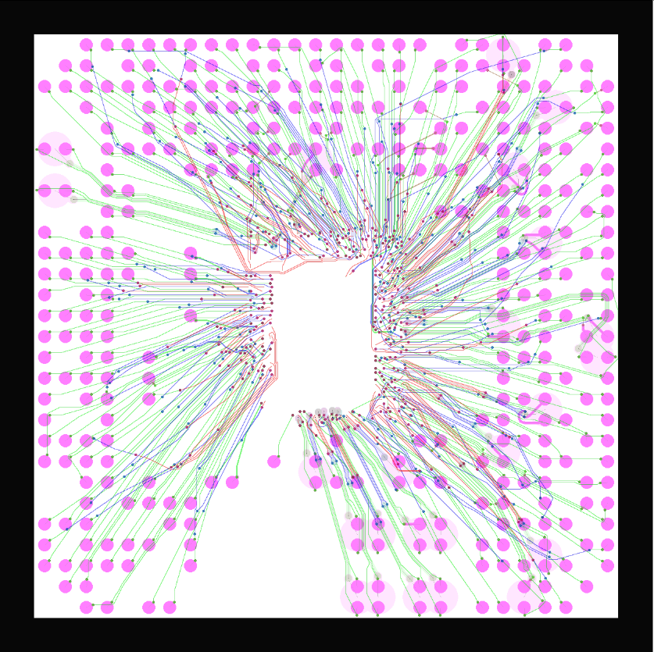

Slide 62
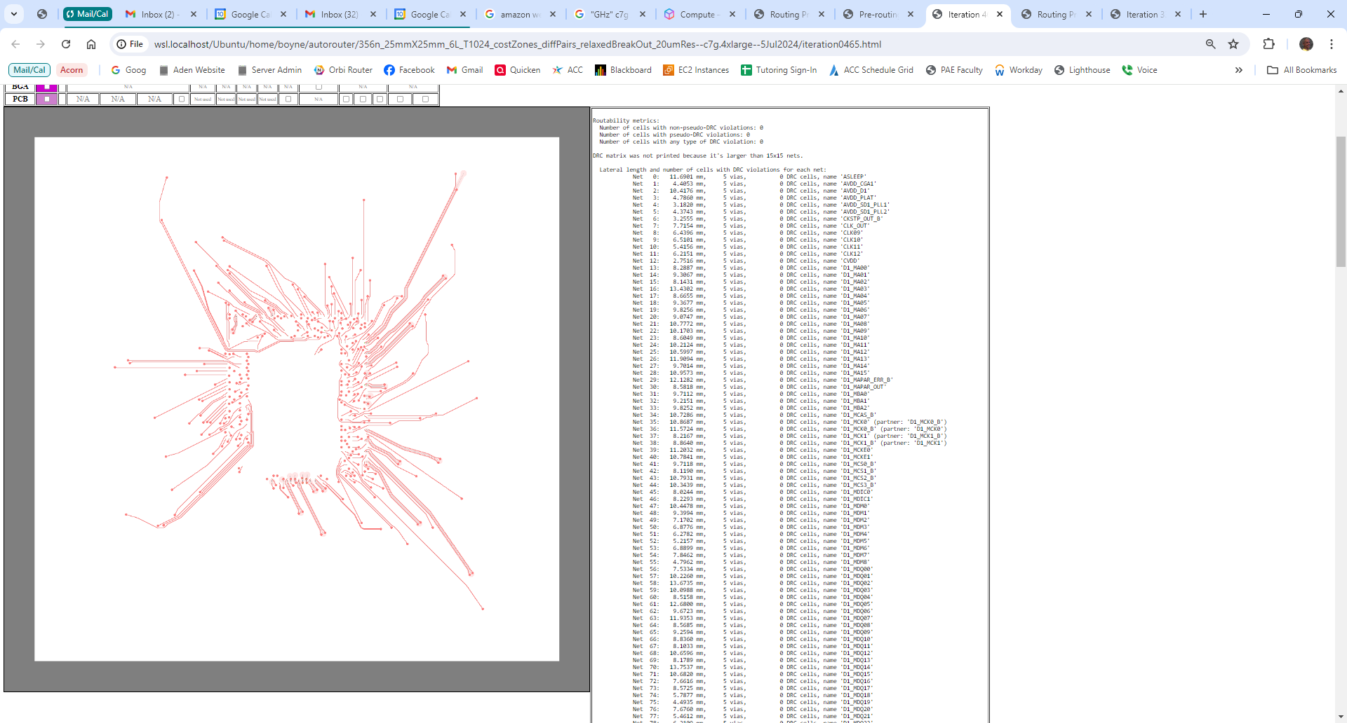
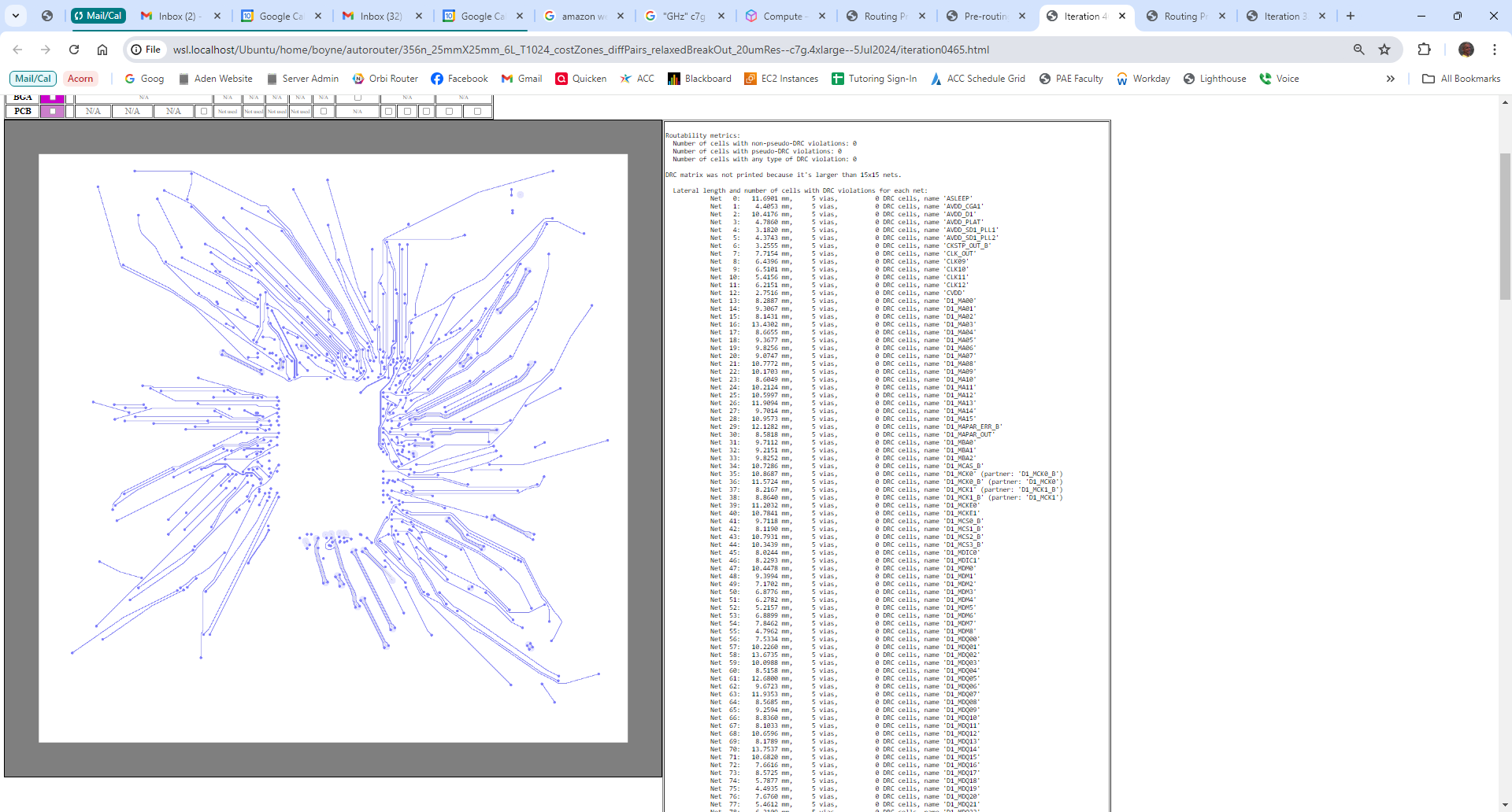
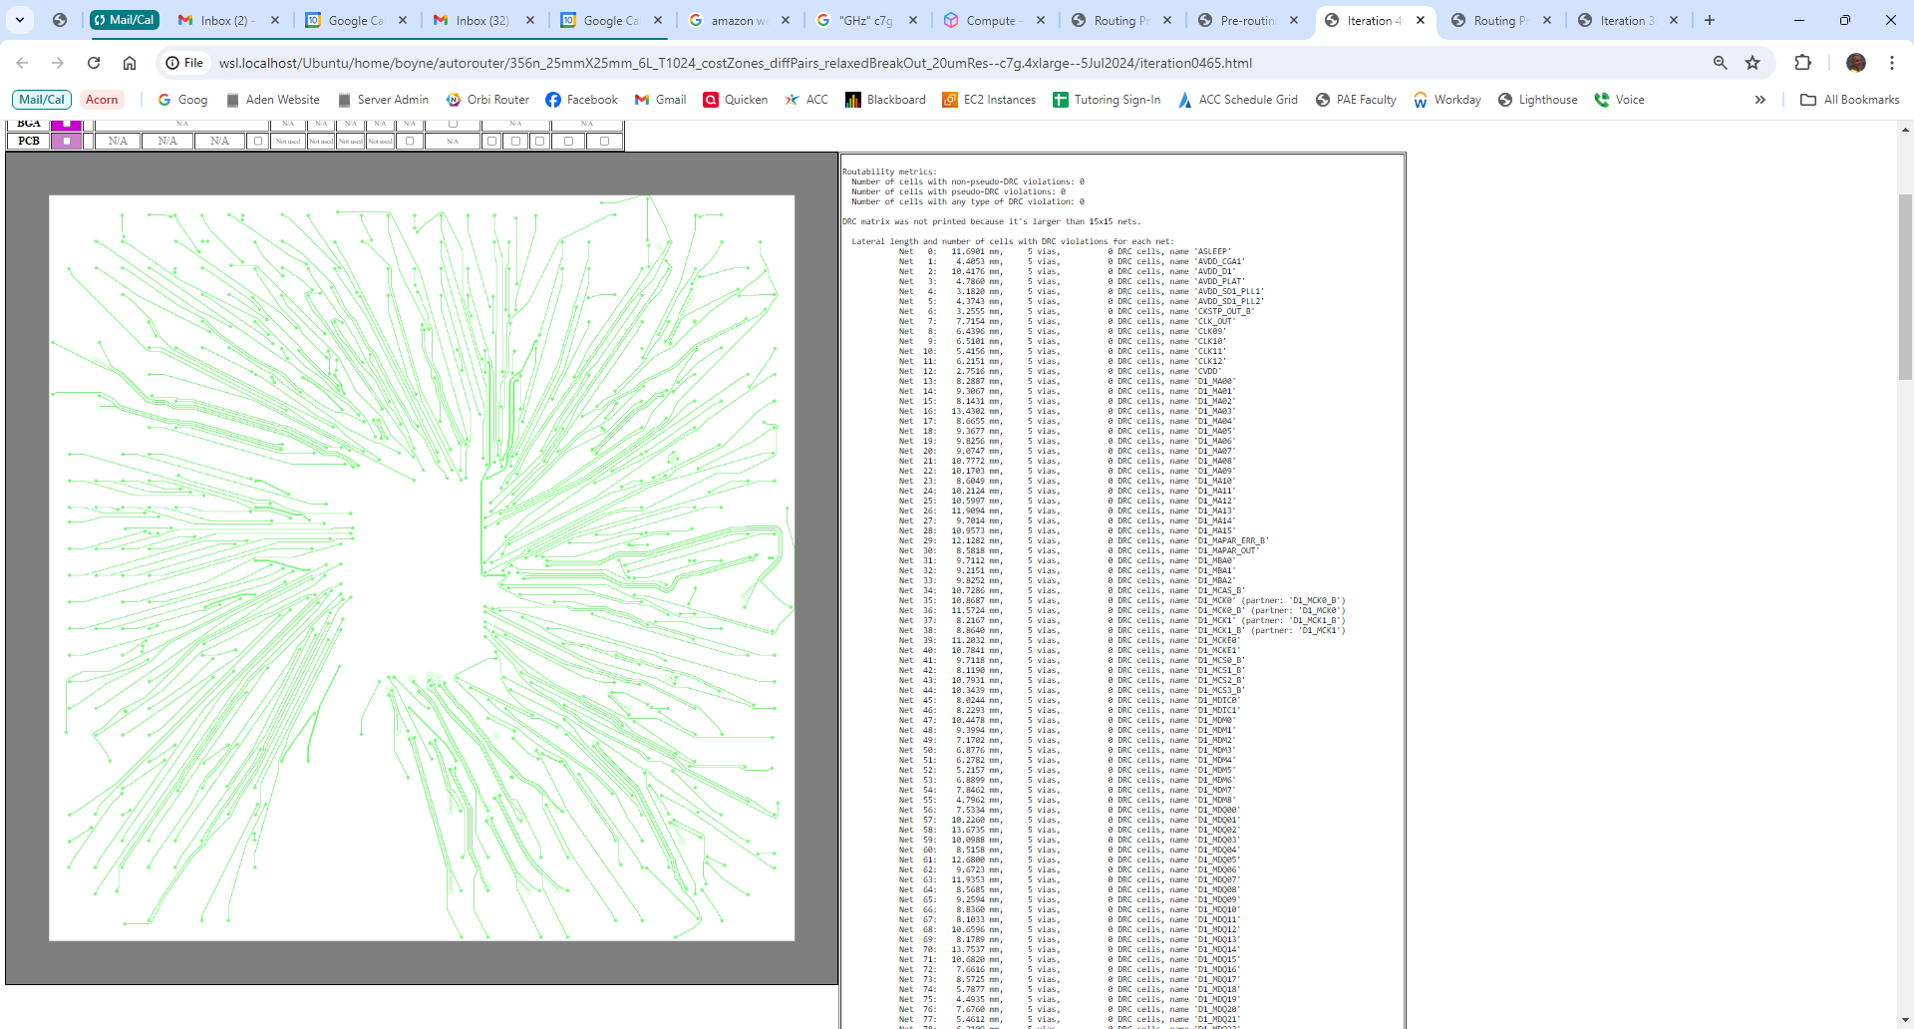
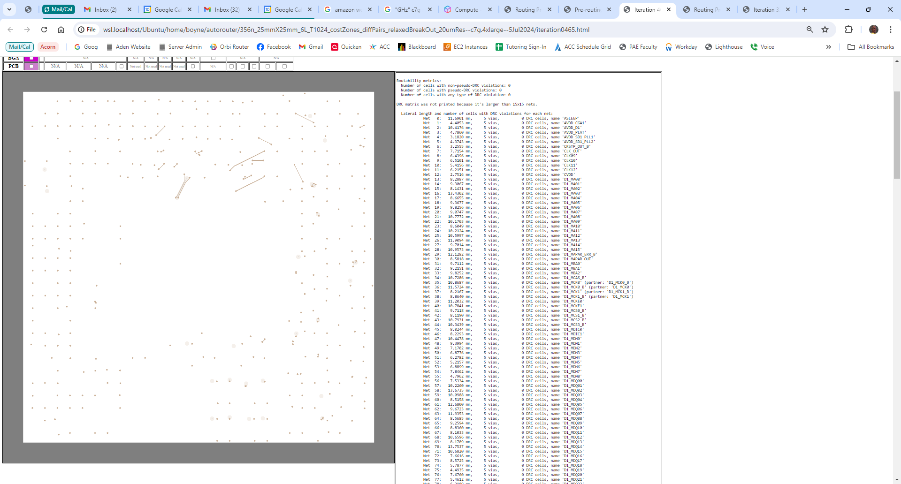
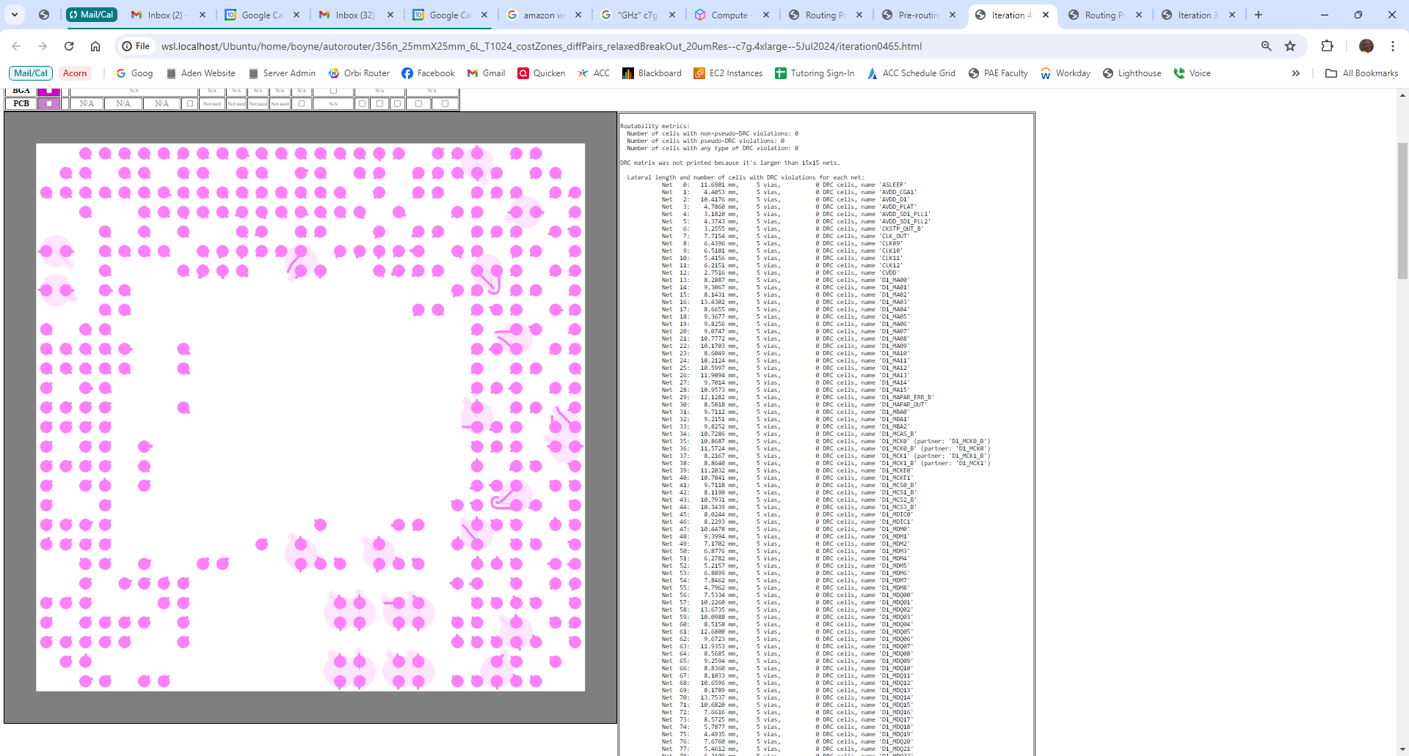

Slide 63
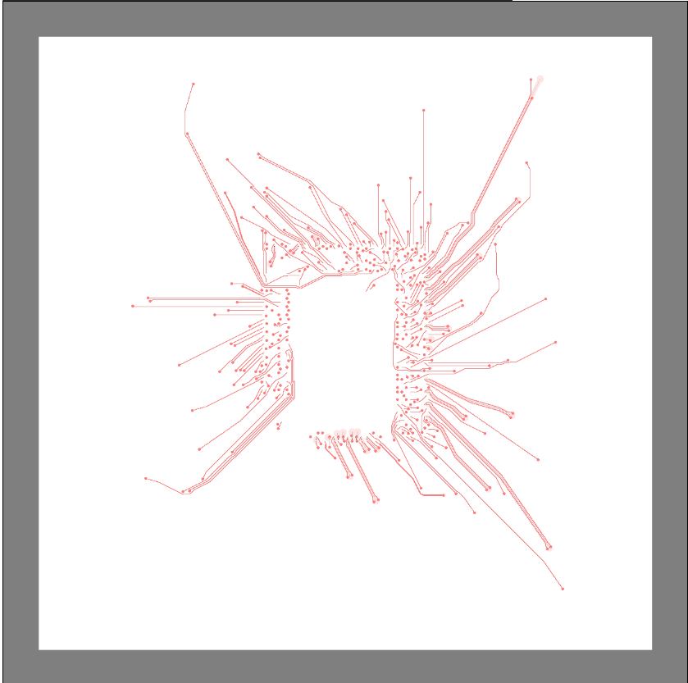
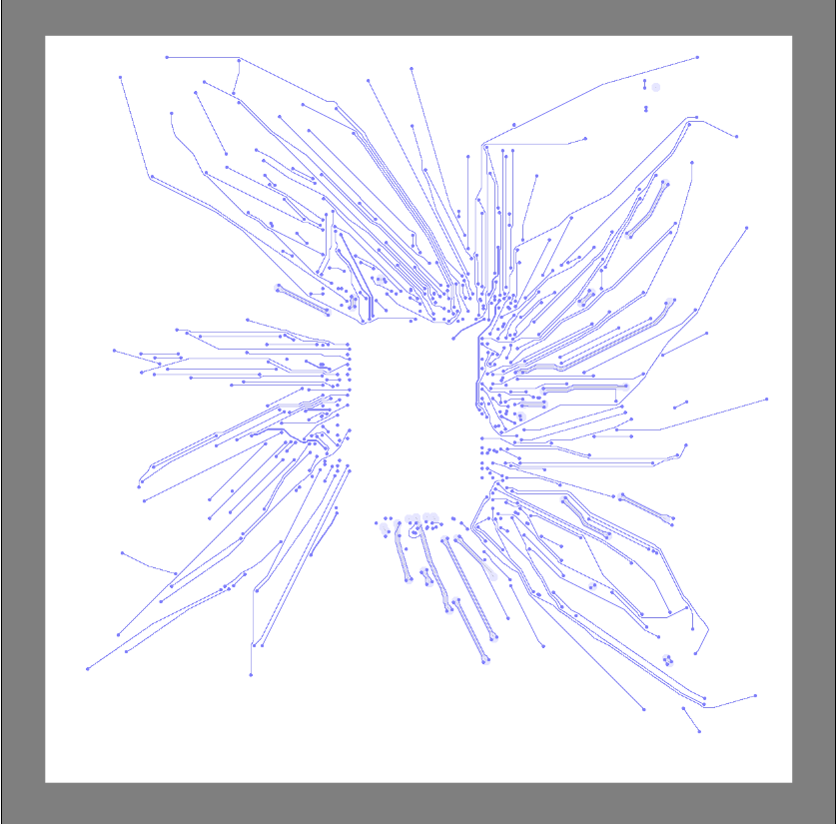
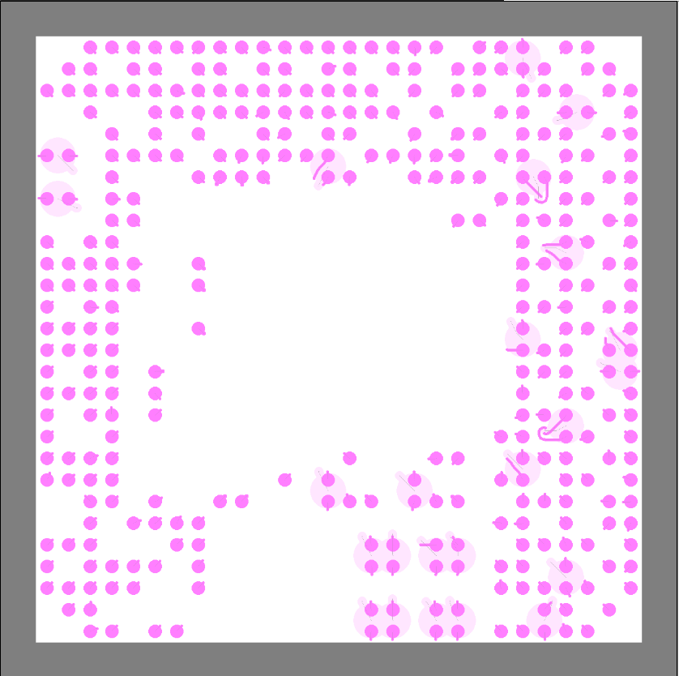

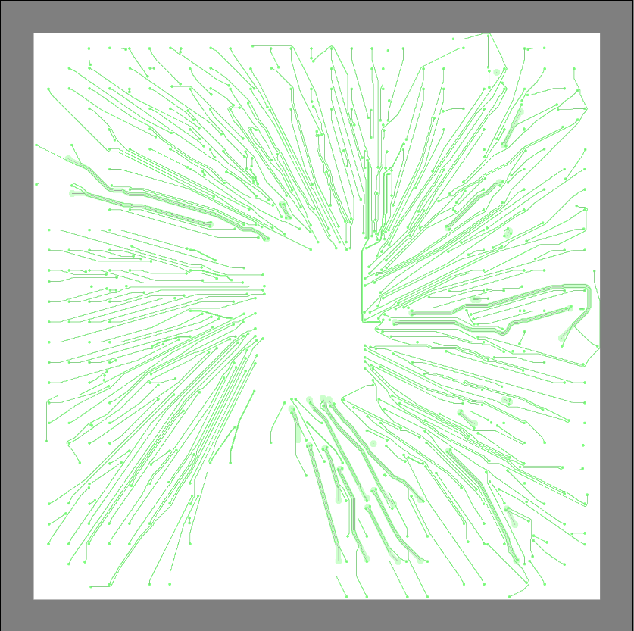
Approximate
die outline
b. Layer 1
a. All layers
c. Layer 2
f. Layer 5
e. Layer 4
d. Layer 3

Slide 64
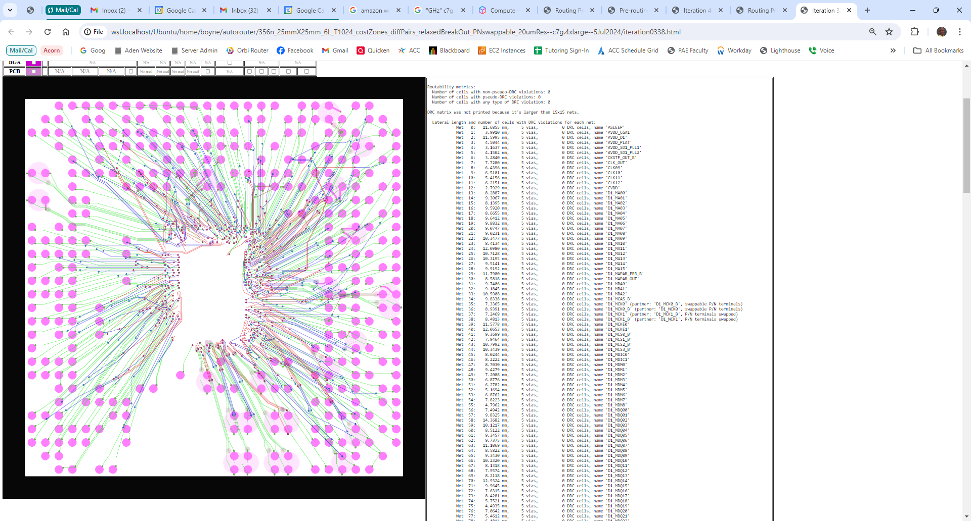
file://wsl.localhost/Ubuntu/home/boyne/autorouter/356n_25mmX25mm_6L_T1024_costZones_diffPairs_relaxedBreakOut_PNswappable_20umRes--c7g.4xlarge--5Jul2024/iteration0338.html

Slide 65
Results: Package & PCB Routing

Slide 66
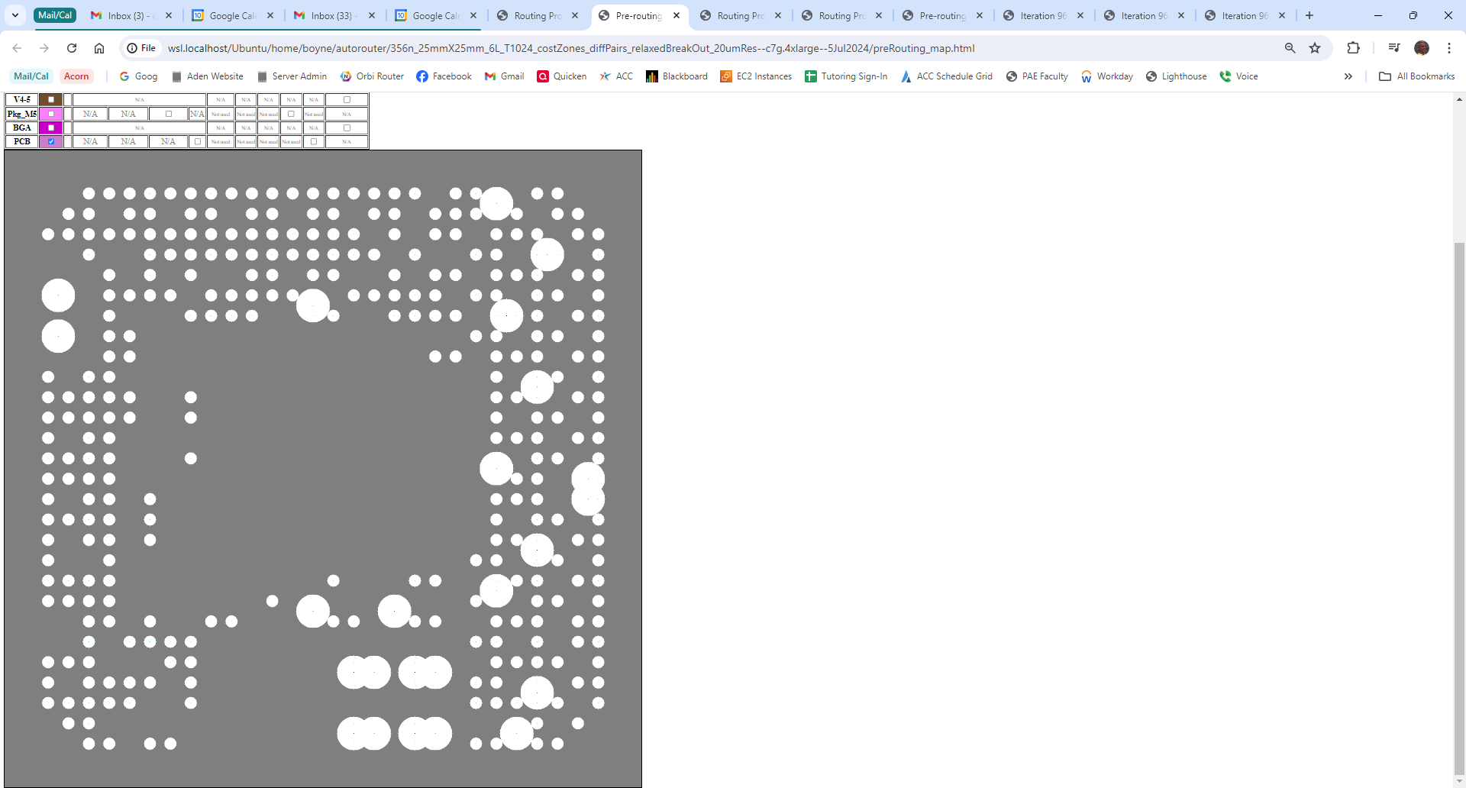
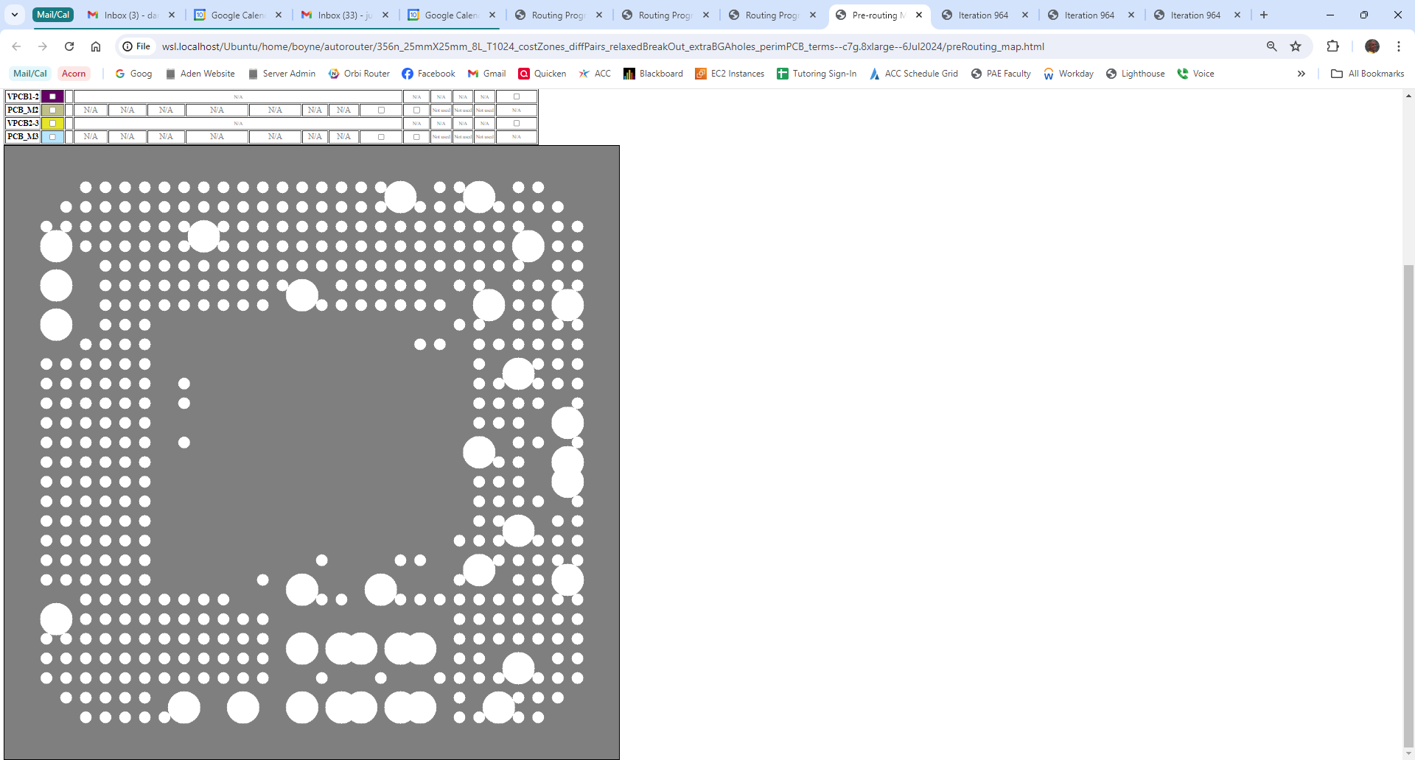
Extra
waypoints
added
No extra
waypoints
a.
b.

Slide 67
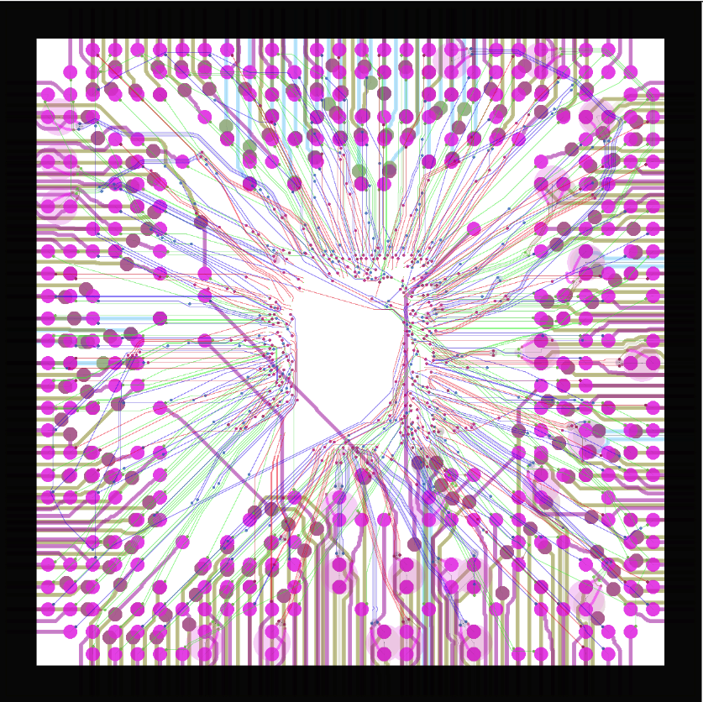
file://wsl.localhost/Ubuntu/home/boyne/autorouter/356n_25mmX25mm_8L_T1024_costZones_diffPairs_relaxedBreakOut_extraBGAholes_perimPCB_terms--c7g.8xlarge--6Jul2024/iteration0964.html

Slide 68
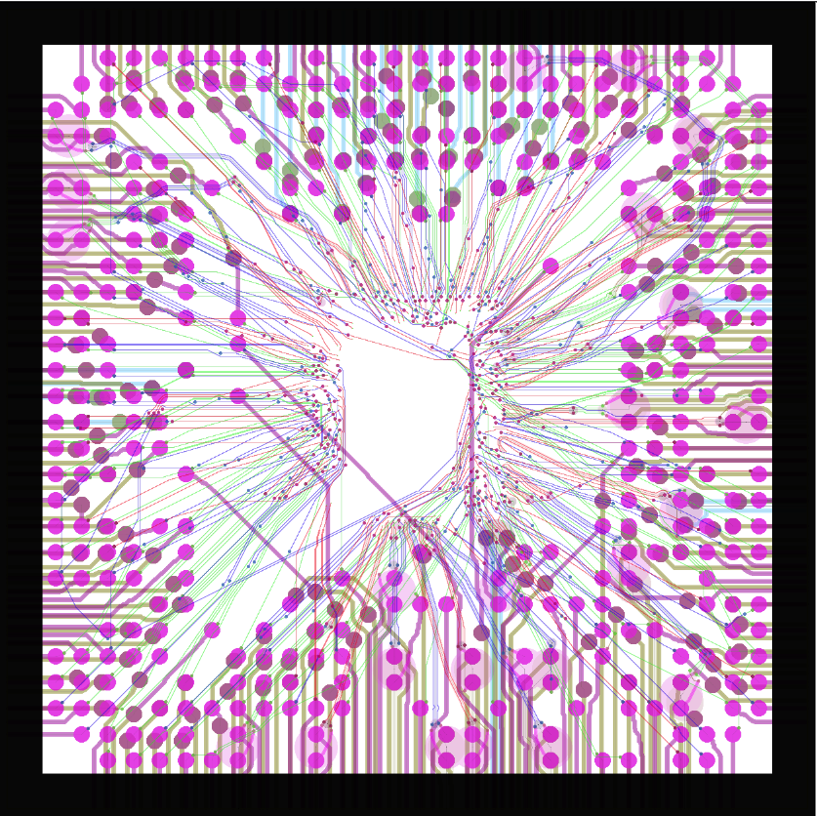
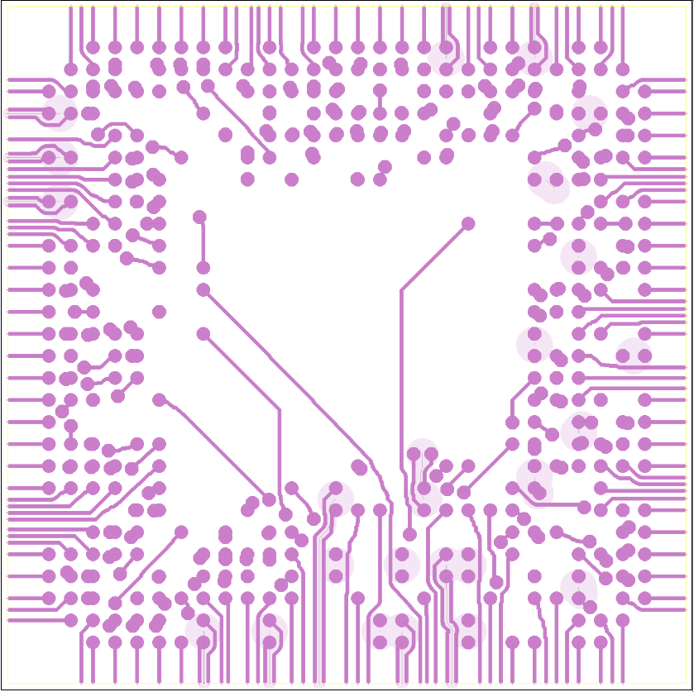
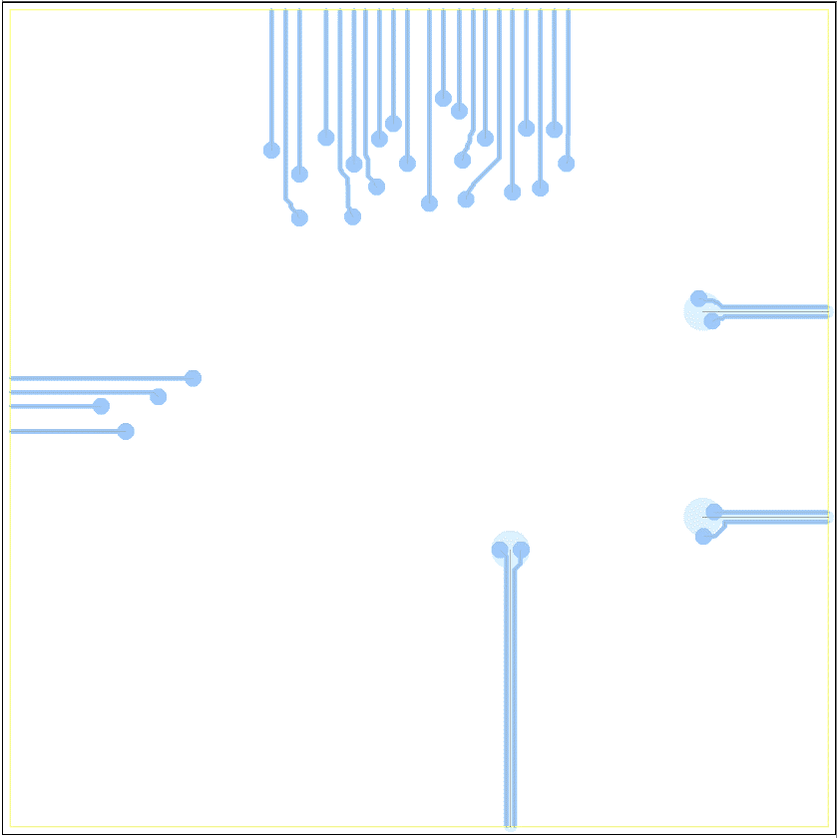
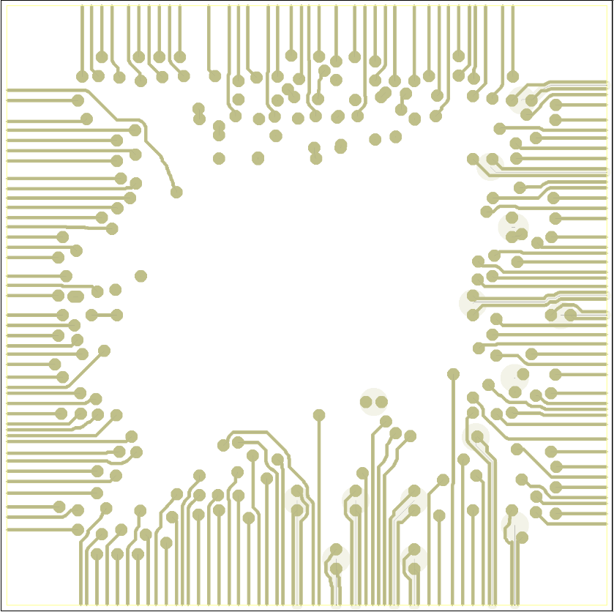
a. All layers
b. PCB layer 1
d. PCB layer 3
c. PCB layer 2

Slide 69
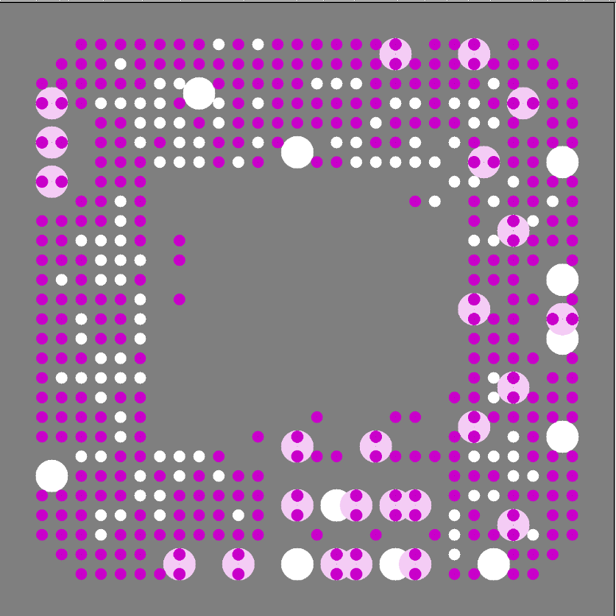

Slide 70
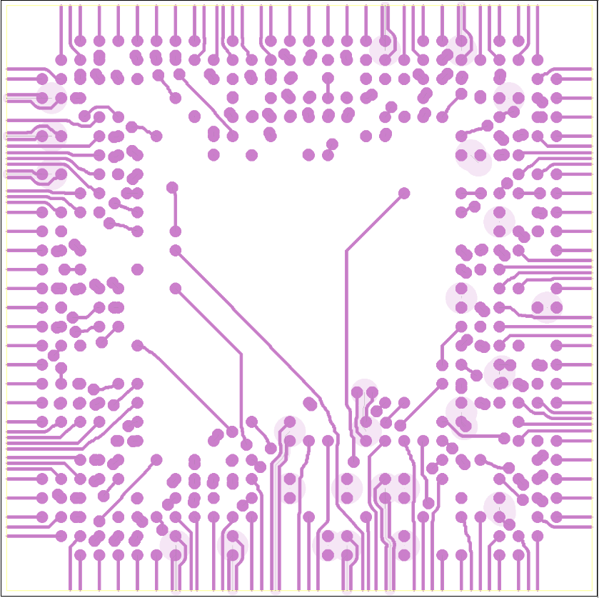

Slide 71


Slide 72


Slide 73
Results: Die, Package and PCB Routing

Slide 74

file://wsl.localhost/Ubuntu/home/boyne/autorouter/356n_25mmX25mm_10L_T1024_costZones_diffPairs_dieTerms_extraC4andBGAholes_perimPCB_terms--c7g.16xlarge--8Jul2024/iteration0919.html

Slide 76


Slide 77


Slide 78



Slide 79



Slide 80


Slide 83
Die terminals (green)
Die
area
Die
routing
Package and
PCB area
Unused C4 sites
(white)
C4 connections
(blue)
RDL (red)

